Slide 1
Gender differences in EEG features while driving
Presenter: Igor Stančin
Paper authors: Igor Stančin, Krešimir Friganović, Mirta Zelenika Zeba, prof. dr. sc. Mario Cifrek, assoc. prof. dr. sc. Alan Jović
University of Zagreb Faculty of Electrical Engineering and Computing
Berlin, Germany, virtual format in Zoom, 19. 11. 2020.

Slide 2
Content
Introduction
Experiment design
EEG features
Results
Conclusion
1 / 11

Slide 3
Introduction
In Ireland, in 2001, it was ten times more likely for a male driver to be killed in an accident than for a female driver (National Roads Authority, 2002)
In general, spatial orientation tasks are harder for women (Kimura, 1999)
Female drivers are involved in accidents due to errors of perceptual nature and judgment error (Storie, 1999)
2 / 11

Slide 4
Experiment design
Seven male and seven female healthy participants
40 minutes of driving in simulation on both, highway roads and in an urban city environment
Used four regions are shown in Table 1 and three electrodes (Oz, Pz and Cz)
Table 1. Electrodes in brain region
Region | Electrodes
Front left (FL) | F7, F3, FC5, FC1, T7
Front right (FR) | F8, F4, FC6, FC2, T8
Occipital left (OL) | O1, P7, P3, CP5, CP1
Occipital right (OR) | O2, P4, P8, CP6, CP2
3 / 11

Slide 5
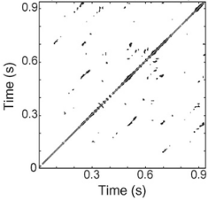
Features
Frequency-domain features:
Delta
Theta
Alpha
Beta
Gamma
Recurrence quantification analysis (RQA):
Determinism (Det)
Laminarity (Lam)
Recurrence rate (RR)
Trapped time (TT)
Determinism divided by recurrence rate (Det/RR)
Longest diagonal (Lmax)
Longest vertical line (Vmax)
Average diagonal line length (Adll)
Divergence (Div)
Entropy (Ent)
Figure 1. Recurrence plot
4 / 11

Slide 6
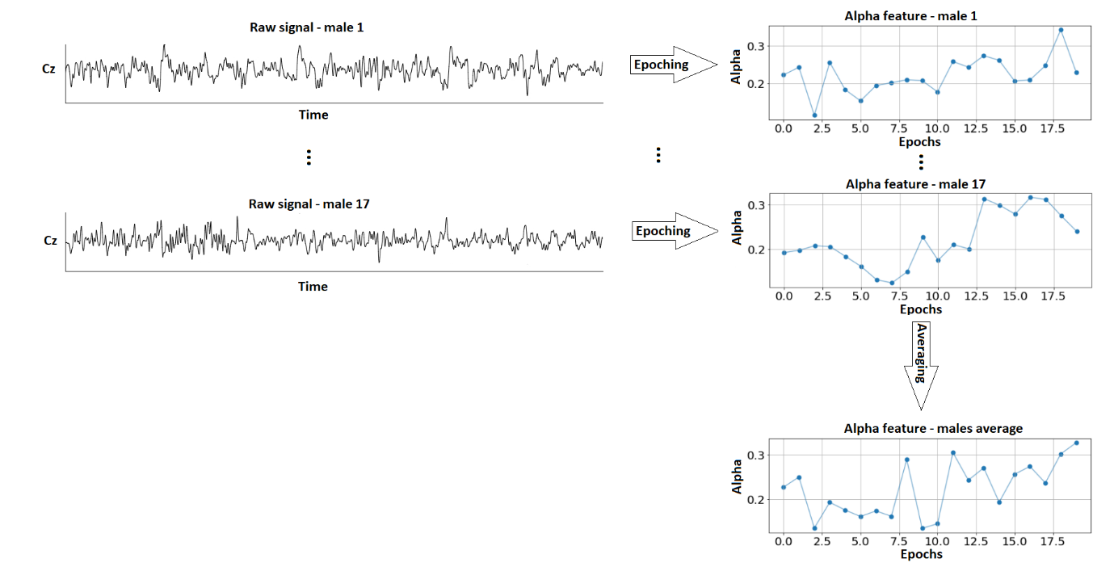
Features
Figure 2. Illustration of the process for obtaining time-series of Cz channel alpha feature for male drivers
5 / 11

Slide 7
Results
Mann–Whitney U test
Bonferroni correction
α=9.26*10⁻⁶
Table 2. Features with lowes p value
Table 3. Features with highest p value
Feature | p value
Pz_RR | 1.15E-89
Pz_Beta | 1.15E-89
FL_Lam | 1.15E-89
Pz_Lam | 1.15E-89
OL_Lmax | 1.15E-89
OL_RR | 1.15E-89
OL_Lam | 1.15E-89
OR_RR | 1.15E-89
OR_Lam | 1.15E-89
FL_Vmax | 1.16E-89
Feature | p value
OR_Gamma | 2.21E-03
Oz_Beta | 2.48E-03
Oz_Ent | 3.33E-03
Cz_Vmax | 4.79E-03
Oz_Gamma | 4.92E-03
Oz_Adll | 1.00E-02
Cz_TT | 1.23E-02
Pz_Alpha | 2.65E-01
FR_Theta | 5.86E-01
Cz_Ent | 6.76E-01
6 / 11

Slide 8
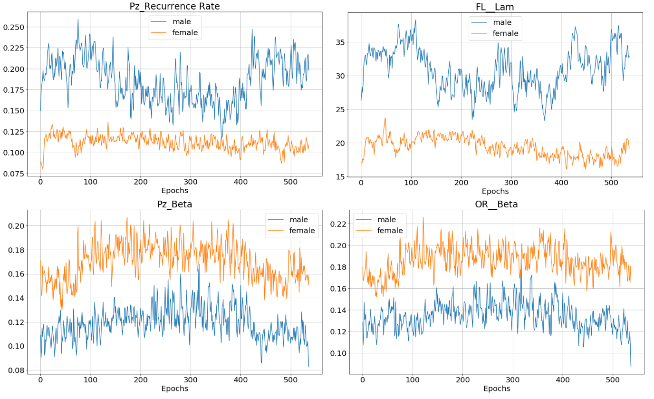
Results
Figure 3. Difference between male and female drivers
7 / 11

Slide 9
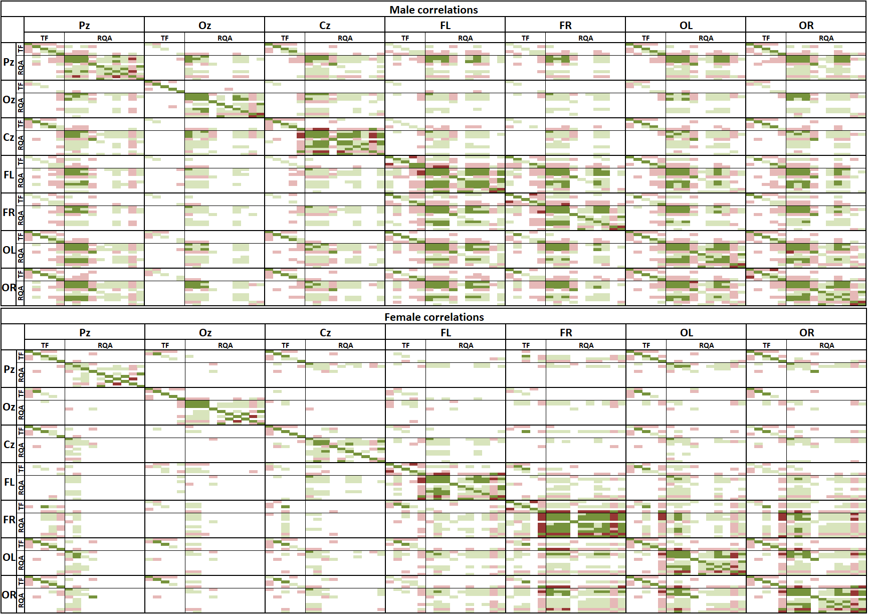
Results
Figure 4. Correlation for male and female drivers with color-coded values. White – correlation between -0.4 and 0.4, light green – correlation between 0.4 and 0.7, dark green – correlation between 0.7 and 1, light red – correlation between -0.4 and -0.7 and dark red – correlation between -0.7 and -1.
8 / 11

Slide 10
Results
Figure 5. On the left: highly correlated determinism (Det) from the FR region and laminarity (Lam) from the FL region for male drivers; on the right: weakly correlated determinism from the FR region and laminarity from the FL region for female drivers.
9 / 11

Slide 11
Conclusion
Frequency domain and RQA features differ significantly between male and female drivers
Male drivers have stronger inter channels/regions correlations
These differences could reflect the differences in their information processing strategies during driving
10 / 11

Slide 12
Future work
Increase number of participants
Measuring differences between the male and female drivers in drowsy state
Find the link between drowsiness, gender, driving performance and different cognitive tasks
Classification of male and female drivers based on the EEG signal features
11 / 11

Slide 13
Thank you!
Questions?

