Slide 1
A web platform for analysis of multivariate heterogeneous biomedical time-series - a preliminary report
Alan Jovic, Davor Kukolja, Kresimir Jozic, Marko Horvat
E-mail: alan.jovic@fer.hr
University of Zagreb, Faculty of Electrical Engineering and Computing
Department of Electronics, Microelectronics, Computer and Intelligent Systems

Slide 2
Content
Motivation
Methodology
Scenarios for Platform Use
Data input
Preprocessing, visualization and feature extraction
Machine learning algorithms and reporting
Platform architecture
Conclusion
Current progress

Slide 3
Motivation
In recent years, the field of web-based telemedicine, has been rapidly evolving:
The need to reduce the cost of healthcare expenditure in developed countries
To facilitate access to a better healthcare
A step further in medicine would be the development of a system for automatic classification of human body disorders based on the analysis of biomedical signals:
Recommendations to medical specialists in diagnostics and early detection of various diseases

Slide 4
GOAL
Construction of innovative web platform that would support multivariate analysis of heterogeneous biomedical time-series (BTS):
Web browser data input
The analysis of a large number of different BTS and their individual, domain specific features
Visualization of signal and disorder
Detection, classification, or prediction of various health disorders based on machine learning algorithms
Reporting

Slide 5
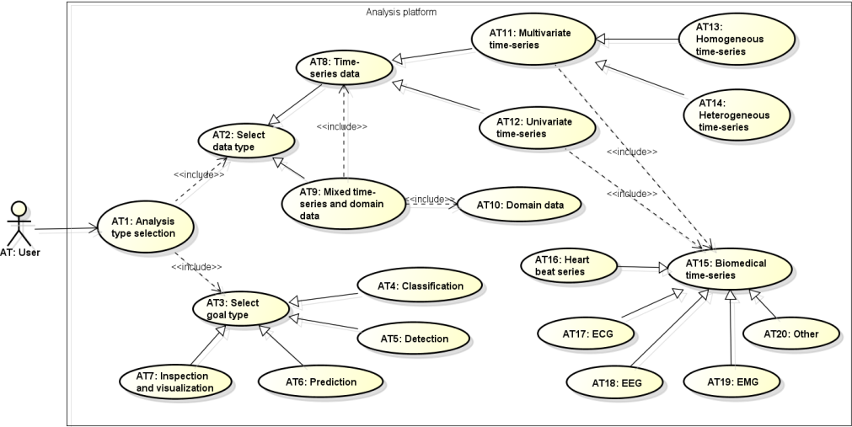
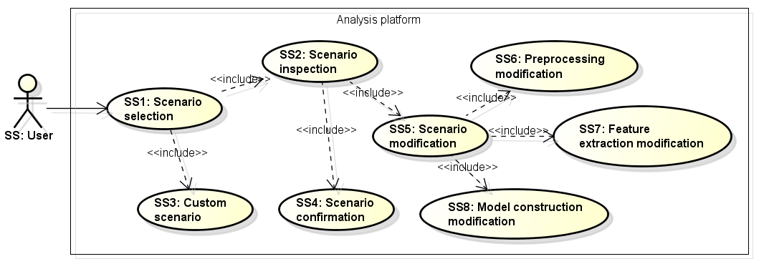
Scenarios for Platform Use
The analysis process is divided into 8 steps:
Analysis type selection
Scenario selection
Input data selection
Records inspection
Records preprocessing
Feature extraction
Model construction
Reporting
Analysis type selection
Scenario selection

Slide 6
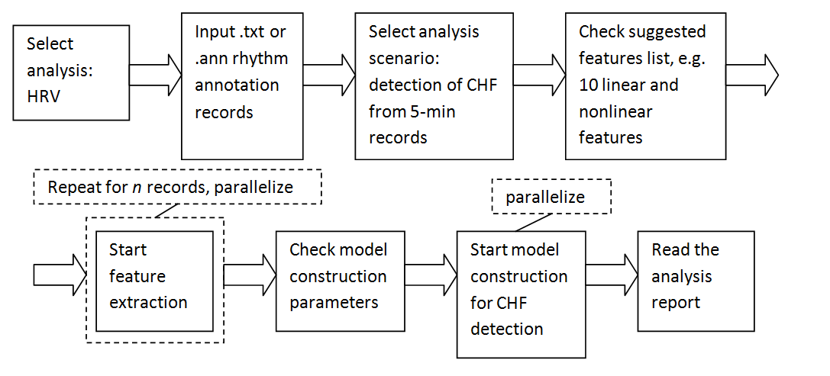
Scenarios for Platform Use
An example flow-based diagram of analysis scenario:
Model construction for detection of congestive heart
failure (CHF) based on heart rate variability (HRV)
from 5-minute segments

Slide 7
Data input
The platform will enable multiple heterogeneous BTS analysis:
ECG, HRV, EEG, EMG, …
Support for input data records containing a variable number of data arrays
We have considered a number of formats, and in the end, we opted to support:
European data format (EDF/EDF+)
Textual formats for signals and annotations (ANN, TXT, CSV)
Image formats JPEG and TIFF.

Slide 8
Preprocessing and visualization
2D visualization of the uploaded records:
Segments selection, temporal and amplitude scaling, lead(s) selection, header information inspection, …
Preprocessing:
Baseline correction, noise and other filtering, detection of characteristic waveforms, …
Data transformations:
Time domain (e.g. PCA), frequency domain (e.g. FFT), time-frequency domain (e.g. WT) transformations
3D visualization of patient disorders or feature extraction depending on the desired analysis goal

Slide 9
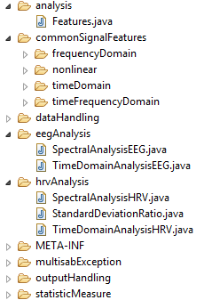
Feature extraction
For BTS feature extraction, we plan to implement:
Domain-specific features
(e.g. RMSSD for HRV)
General time-series features
(e.g. approximate entropy,
correlation dimension, etc.)
The algorithms from:
HRVFrame, EEGFrame
Comp-Engine [Fulcher 2013]
Additional domain specific feature extraction frameworks
Feature extraction will be parallelized
Optimally utilization of the available system resources

Slide 10
Machine learning algorithms and reporting
Dimensionality reduction:
Removing irrelevant and redundant features
Expert system recommendation
Typical filters and wrappers feature selection methods
Machine learning algorithms
For detection and classification models, tree-based and SVM-based algorithms will be provided
It will be possible to evaluate the data using standard evaluation procedures (i.e. holdout, cross-validation), both patient-wise (personalized) or regardless of the patient
For reporting purposes Java-based JasperReports Library will be used:
Web form report, with the possibility to export to PDF, Excel, OpenOffice, and Word documents.

Slide 11
Platform architecture
The analysis platform will be created as a web application:
End user base will be larger
Application development and maintenance will be less demanding
Java was selected for server side mainly because of a large base of existing libraries for signal processing, data parsing, machine learning, and parallelization.
On the client side, HTML5, Typescript, and CSS3 will be used for the design of web pages.
Client-side platform (frontend) will be developed using Angular 2 framework.

Slide 12
Conclusion
A thorough examination of contemporary technologies for construction of a web platform in the field of multivariate BTS analysis was performed
The presented platform will feature a complete process of BTS data records analysis and visualization, with special attention devoted:
Efficiency
System upgradeability
Ease-of-use
Application development and maintenance

Slide 13
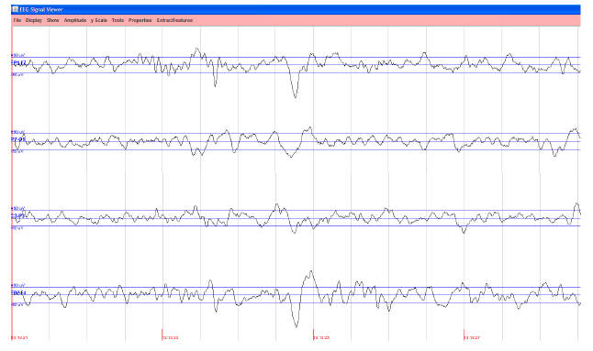
Current progress
Database architecture is defined
h2 DBMS is used
Data input and signal processing framework is under development
The algorithms from HRVFrame and EEGFrame are refactored and verified
Test version of backend and frontend is developed to test secure authentication

