Slide 1


Optimizing the detection of characteristic waves in ECG based on exploration of processing steps combinations
Authors: Krešimir Friganović, Alan Jović, Davor Kukolja, Mario Cifrek and Goran Krstacic

Slide 2
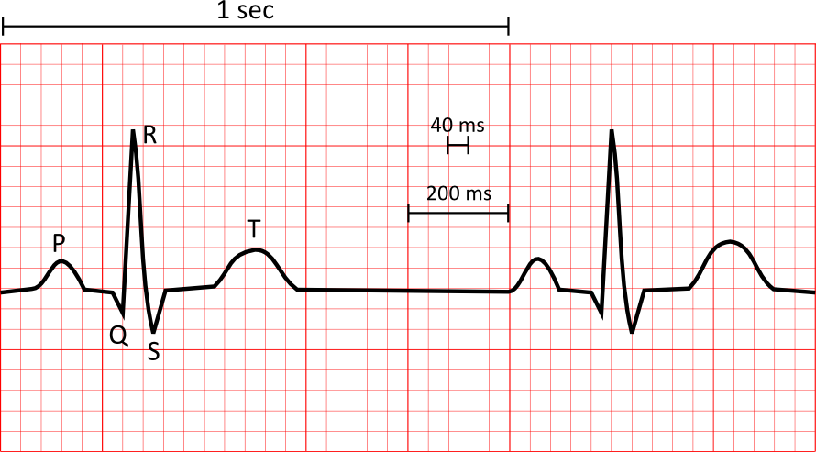
Importance of ECG wave deteciton
AF: P wave absence, f waves (fibrillatory rate), QRS interval
AMI: J point amplitude (from baseline), R/S ratio, T wave amplitude, ST segment slope, QT interval variability
CHF: Q wave amplitude, PR interval, P wave am-plitude, R wave amplitude, QRS duration, S wave duration, R wave duration
AF – atrial fibrillation; AMI - acute myocardial ischemia; CHF - congestive heart failure

Slide 3
Detection algorithms
Pan Tompkins:
  QRS complex
  squaring, differentiation, and integration transforms
Elgendi:
  QRS complex and P,T waves
  squaring and two moving averages
Sun Yan:
  QRS complex and P,T waves
  MMD (multiscale morphological derivative) transforms

Slide 4
Processing steps (QRS detection)
Noise and Artifacts Reduction
Transformations
Fiducial marks selection
Decision rules

Slide 5
Processing steps (P and T waves detection)
Noise and Artifacts Reduction
Transformations
Fiducial marks selection
Decision rules
Idea: improve detection by combining processing steps

Slide 6
QRS detection results on MIT-BIH Arrhythmia database
Table 1. MIT-BIH Arrhythmia Database R peak detection accuracy
Algorithm | TP | FP | FN | Se (%) | +P (%)
Pan Tompkins | 98461 | 524 | 412 | 99.58 | 99.47
Elgendi | 98515 | 376 | 358 | 99.64 | 99.62
MMF + Pan Tompkins | 98313 | 605 | 560 | 99.43 | 99.39
MMF + Elgendi | 98650 | 277 | 223 | 99.77 | 99.72
Elgendi + Adaptive Thresholding | 97113 | 237 | 1760 | 98.22 | 99.76
MMD + Elgendi | 97610 | 1218 | 1263 | 98.72 | 98.77
MMF + MMD + Elgendi | 97939 | 874 | 934 | 99.06 | 99.12

Slide 7
QRS detection results on QT database
Table 2. QT Database R peak detection accuracy
Algorithm | TP | FP | FN | Se (%) | +P (%)
Pan Tompkins | 11637 | 107 | 407 | 96.62 | 99.09
Elgendi | 11962 | 84 | 82 | 99.32 | 99.30
MMF + Pan Tompkins | 11931 | 110 | 113 | 99.06 | 99.09
MMF + Elgendi | 11944 | 116 | 100 | 99.17 | 99.04
Elgendi + Adaptive Thresholding | 11644 | 44 | 400 | 96.68 | 99.62
MMD + Elgendi | 12032 | 13 | 12 | 99.90 | 99.89
MMF +MMD + Elgendi | 12020 | 24 | 37 | 99.80 | 99.69

Slide 8
P and T waves detection results on MIT-BIH Arrhythmia database
Table 3. MIT-BIH Arrhythmia Database P and T wave detection accuracy
Algorithm | TP | FP | FN | Se (%) | +P (%)
Elgendi P wave | 58404 | 39579 | 37585 | 60.84 | 59.61
Elgendi T wave | 87365 | 6025 | 11030 | 88.79 | 93.55
MMF + Elgendi P wave | 52269 | 46451 | 43720 | 54.45 | 52.95
MMF + Elgendi T wave | 87714 | 7489 | 10981 | 89.14 | 92.13

Slide 9
P and T waves detection results on QT database
Table 4. QT Database P and T wave detection accuracy
Algorithm | TP | FP | FN | Se (%) | +P (%)
Elgendi P wave | 349 | 103 | 103 | 77.21 | 77.21
Elgendi T wave | 328 | 124 | 124 | 72.57 | 72.57
MMF + Elgendi P wave | 75 | 73 | 377 | 16.59 | 50.68
MMF + Elgendi T wave | 286 | 53 | 166 | 63.27 | 84.37

Slide 10
Conclusion and Future work
Combinations of processing steps improved detection (noise and artifact reduction)
Problem of P and T annotations
Future work:
  expand research and explore other known methods for ECG waves detection, such as wavelet and phasor transform algorithms

Slide 11

Thank you for your attention!

