Slide 1
Feature extraction from electroencephalographic records using EEGFrame framework
Alan Jović, Lea Suć, Nikola Bogunović
Faculty of Electrical Engineering and Computing, University of Zagreb
Department of Electronics, Microelectronics, Computer and Intelligent Systems

Slide 2
Contents
Motivation
EEGFrame overview
EEG visualization
Features
Comparison to similar work
Conclusion

Slide 3
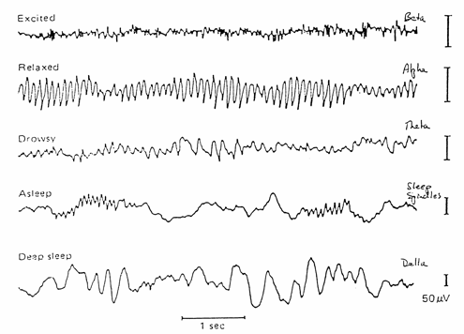
Motivation
Electroencephalogram (EEG) and magnetoencephalogram (MEG)
Brain disorder (epilepsy, Alzheimer’s, schizophrenia, etc.) and state of consciousness (awake, dream, deep sleep) assessment methods
Non-invasive measurements
High temporal resolution

Slide 4
Motivation
Biomedical time-series (EEG/MEG, ECG, EMG, heart rate, etc.) are inherently nonlinear, with periods of randomness and determinism
EEG in particular shows high degree of complexity when functioning normally
Complexity loss is pronounced in disorders such as epilepsy and Alzheimer’s
Non-stationarities (atypical behavior) occur often without warning
Noise often poses problems
Biodiversity complicates general model construction

Slide 5
Motivation
Which types of analyses?
Functional connectivity ¹
Complexity modelling ²
Disorder detection/classification ³
Disorder onset prediction ⁴
¹ J. Sun, X. Hong, S. Tong, Phase Synchronization Analysis of EEG Signals: An Evaluation Based on Surrogate Tests, IEEE Trans Biomed Eng 59(8): 2254-2263, 2012.
² R. Hornero, D. Abásolo, J. Escudero, C. Gómez, Nonlinear analysis of electroencephalogram and magnetoencephalogram recordings in patients with Alzheimer’s disease, Phil. Trans. R. Soc. A 367:314-336, 2009.
³ Y. Song, J. Zhang, Automatic recognition of epileptic EEG patterns via Extreme Learning Machine and multiresolution feature extraction, Expert Systems with Applications 40:5477-5489, 2013.
⁴ F. Mormann, C.E. Elger, K. Lehnertz, Seizure anticipation: from algorithms to clinical practice. Curr. Opin. Neurol. 19:187, 2006.

Slide 6
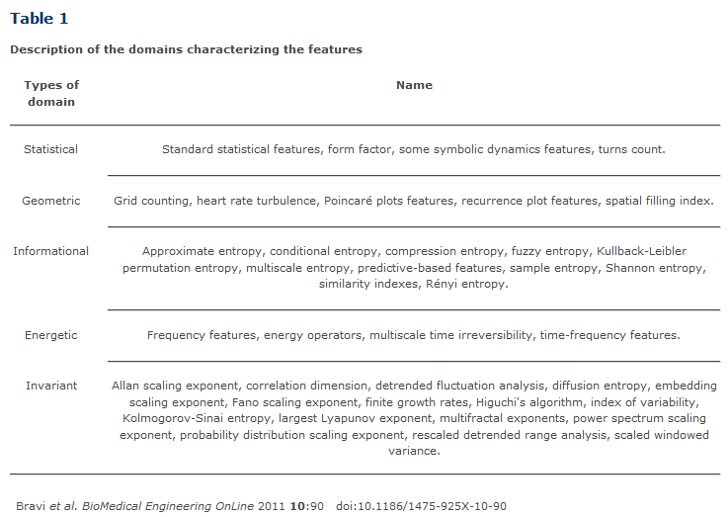
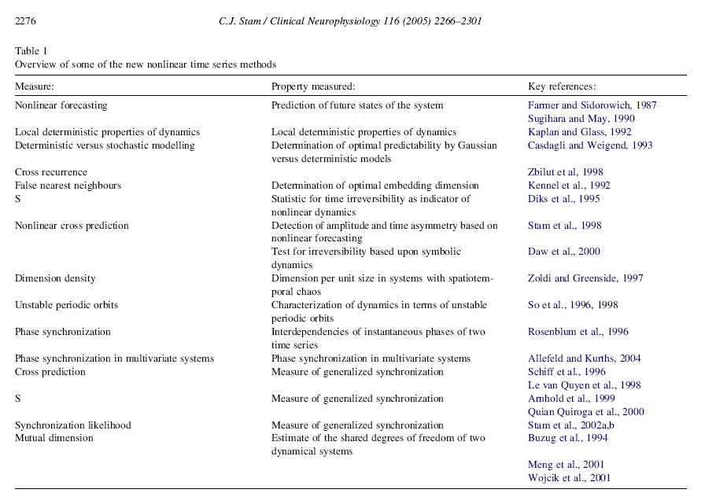
Motivation
Complexity and variability of a time-series can be quantified using many approaches
For comparing two or more time-series, additional methods are available

Slide 7
Motivation
Very few open-source, freely available frameworks for EEG/MEG time-series modelling currently available
Not many open-access EEG/MEG records databases available, e.g. PhysioNet
Plethora of possibly applicable features
Difficult repeatability and reliable comparison of scientific work in this domain

Slide 8
EEGFrame overview
Record loading
EEG file in .edf format
Output .csv file for knowledge discovery
Signal selection
Feature selection
Feature vector storing
Signal viewer
Feature extraction
Knowledge discovery platform
[Repeat if required]
EEGFrame framework
EEGFrame is a Java-based, open-source, freely available framework for feature extraction and EEG visualization
EEG record -> feature extraction -> knowledge discovery

Slide 9
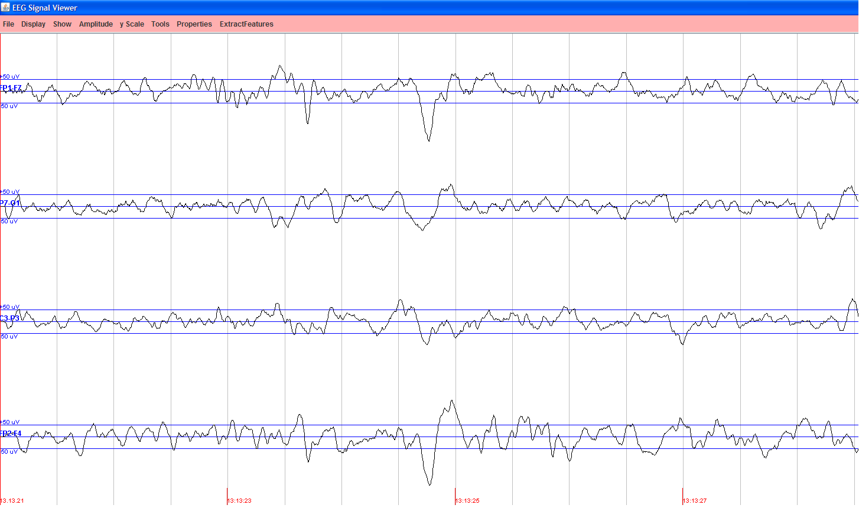
EEG visualization
Visualization of the EEG record chb01_27.edf from PhysioNet CHB-MIT database for electrodes FP1-F7, P7-O1, C3-P3, and FP2-F4.

Slide 10
Implemented features
Univariate methods, mostly derived from HRVFrame*
Variability and complexity description methods
Statistical, geometric, frequency, time-frequency, nonlinear features
Adapted and tested for EEG analysis
Bivariate and multivariate methods
Aimed at multiple EEG trails analysis (e.g. mutual information, synchronization likelihood)
The goal is to quantify both the intensity and direction of two or more time-series correspondence
A topic of recent research
* A. Jović, N. Bogunović, HRVFrame: Java-Based Framework for Feature Extraction from Cardiac Rhythm, Lecture Notes in Artificial Intelligence. 6747 (2011) ; 96-100.

Slide 11
Implemented features
EEGFrame is divided into several packages
Around 50 implemented features in total at the moment, most of them implemented in their own Java class
The focus is on nonlinear features (more than 20 methods: entropy, phase-space, fractal, multivariate, other)
The GUI supports selection of specific features and their parameters (if any) for feature vectors elicitation

Slide 12
Extracting features...

Slide 13
Comparison to similar work
Software | Purpose | Implementation language | Type | Implemented features
EEGLab [4] | Extensive Matlab toolbox for EEG analysis: visualization, 3D brain modelling, feature extraction, several plugins (NFT, ERICA, BCILAB...) | Matlab | Embedded | Time/frequency/time-frequency/independent component transformations and features / unknown total number of features
BioSig [5] | Reading and writing routines for many biomedical time-series data formats; EEG preprocessing, visualization, feature extraction (multivariate autoregressive modeling) and classification (via Matlab/Octave) | C/C++, Matlab (or Octave) | Some functions standalone, mostly embedded | Time/frequency/time-frequency transformations and features, unknown total number of features
PyEEG [6] | Feature extraction framework, feature vector output for data mining | Python | Embedded | Frequency/nonlinear features, currently 21 features in total
EEGFrame | Signal inspection, feature extraction framework, handles .EDF input, feature vector output for data mining | Java | Stand-alone or embedded | Time/frequency/time-frequency/nonlinear features, currently 49 features in total

Slide 14
Conclusion
Extensive framework with univariate and multivariate features implementations in Java
Stand-alone framework, with possibility of embedding for research and commercial purposes
Still in development, available at:
http://www.zemris.fer.hr/~ajovic/eegframe/eegframe.html
Additional features’ implementations are planned for the future (Hjorth parameters, SVD entropy, neural complexity C_{N}, etc.)

Slide 15
Thank you!

