Slide 1
An overview of free software tools for general data mining
Alan Jović, Karla Brkić, Nikola Bogunović
E-mail: {alan.jovic, karla.brkic, nikola.bogunovic}@fer.hr
Faculty of Electrical Engineering and Computing, University of Zagreb
Department of Electronics, Microelectronics, Computer and Intelligent Systems

Slide 2
Contents
Motivation and goal
DM tools’ general characteristics
DM algorithms supported
DM advanced tasks supported
Overall recommendations
Conclusion

Slide 3
Motivation
A problem that requires DM
business-oriented (e.g. churn detection, direct marketing, sentiment analysis...)
research-oriented (e.g. computer vision, biomedical data analysis, chemometrics...)
Many algorithms for DM
Which one should I use? Are there any others similar?
Many open-source and commercial DM tools available
Steady development progress in the last 20-25 years
Wikipedia currently lists more than 30 significant DM tools, many specialized

Slide 4
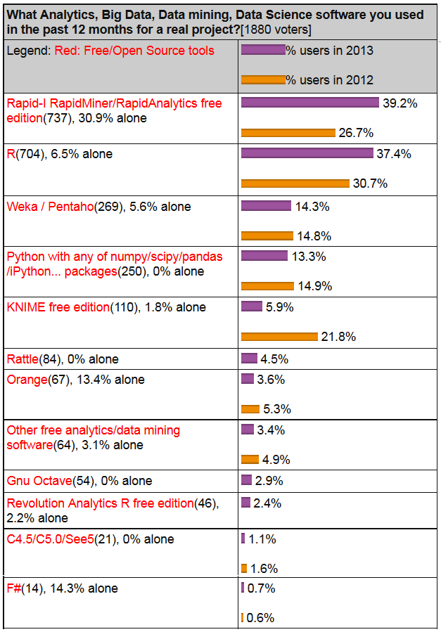
Goal
Provide a detailed overview of the most commonly used free general DM tools
“Most commonly used” is
based on KDnuggets 2013 poll:
Considered tools include
RapidMiner
R
Weka
KNIME
Orange
scikit-learn

Slide 5
DM tools general characteristics
Characteristic | RapidMiner | R | Weka | Orange | KNIME | scikit-learn
Developer: | RapidMiner, Germany | worldwide development | Univ. of Waikato, New Zealand | Univ. of Ljubljana, Slovenia | KNIME.com AG,Switzerland | multiple; support: INRIA, Google
Programming language: | Java | C, Fortran, R | Java | C++, Python, Qt framew. | Java | Python+NumPy+ SciPy+matplotlib
License: | open s. (v.5 or lower); closed s., free Starter ed. (v.6) | free software, GNU GPL 2+ | open source, GNU GPL 3 | open source, GNU GPL 3 | open source, GNU GPL 3 | FreeBSD
Current version: | 6 | 3.02 | 3.6.10 | 2.7 | 2.9.1 | 0.14.1
GUI / command line: | GUI | both; (GUI for DM = Rattle) | both | both | GUI | command line
Main purpose: | general data mining | sci. computation and statistics | general data mining | general data mining | general data mining | machine learning package add-on
Community support (est.): | large (~200 000 users) | very large (~ 2 M users) | large | moderate | moderate (~ 15 000 users) | moderate

Slide 6
DM algorithms support
An excerpt from Table II (18 categories, ~70 methods):
Support level
+ → supported by the tool
A → supported in an add-on for the tool
S → somewhat supported – possible to achieve, but not directly supported or supported only in part
− → not supported
Category | Method | RapidMiner | R | Weka | Orange | KNIME | scikit-learn
Decision tree learner | ID3 | A (Weka) | − | + | + | A (Weka) | −
 | C4.5 | A (Weka) | A (RWeka) | + | + | − | −
 | CART | A (Weka) | A (RWeka) | + | + | A (Weka) | + (optimized)
 | others | +, A (own*, dec. stump) | +, A (own*, RWeka) | + (dec. stump) | + (own*) | + (own*) | −

Slide 7
DM advanced tasks support
Name | RapidMiner | R | Weka | Orange | KNIME | scikit-learn
Big data | S (not free: Radoop) | A (ff, ffbase) | S (CLI, knowl. flow, distributedWekaHadoop) | − | A | S
Link, graph mining | − | A (igraph, sna) | A | − | A | −
Spatial data analysis | − | A (ggmap) | − | − | A | S
Time-series analysis | A | +, A(forecast) | S (several time series filters) | − | + | S (timeseries module has bugs)
Semi-super-vised learning | S | A (upclass) | S | − | S | + (label propagation)
Data streams | + | A (stream) | A (massiveOnlineAnalysis) | − | + | S
Text mining | A | A (tm, RTextTools, qdap) | S | A | A | +
Paralelization | S (enterprise ed.) | A (snow, multicore) | S | − | + | A (joblib)
Deep learning | − | S (darch: incomplete) | − | − | − | S (Restricted Boltzmann Mach.)

Slide 8
Overall recommendations
RapidMiner: many DM algorithms (also can import Weka’s methods), extendable, steady learning curve, recent problems with licensing
R: strong in statistics and DM algorithms, extendable, fast implementations, complexity of extensions, not user-friendly – some improvement with Rattle GUI
Weka: many DM algorithms, user-friendly, extendable, not the best choice for data visualization or advanced DM tasks at this time
Orange: user-friendly, visually appealing GUI, moderate DM algorithms coverage, doesn’t cover advanced DM tasks at this time
KNIME: user-friendly, extendable (e.g. Weka, R), covers most of the advanced DM tasks as add-ons, no significant downsides
scikit-learn: great documentation, fast implementations, moderate DM algorithms coverage, not user-friendy

Slide 9
Conclusion
Choice of DM tool typically depends on the problem at hand, experience of the DM user, and user-friendliness of the tool
This study provided an overview into DM algorithms implementations coverage for several important DM tools
Based on the overview, we can recommend RapidMiner, R, Weka and KNIME tools
Orange and scikit-learn are still not as powerful, but have their specific advantages
Other free general DM tools still fall behind
Further progress of the tools might be in adoption and perhaps integration of extensions for recent more advanced DM tasks
Also, further integration of methods (collaboration) between the free tools is expected

Slide 10
Thank you!

