Slide 1
Use Case Diagram Based Scenarios Design for a Biomedical Time-Series Analysis Web Platform
Alan Jovic¹, Davor Kukolja¹, Kresimir Jozic², Mario Cifrek¹
E-mail to: alan.jovic@fer.hr
¹ University of Zagreb, Faculty of Electrical Engineering and Computing, Zagreb, Croatia
² INA - industrija nafte, d.d., Zagreb, Croatia

Slide 2
CONTENT
Motivation & goal
Methodology
System requirements
UML use case based modeling
System architecture
Conclusion
Current progress

Slide 3
Motivation & goal
In recent years, the field of web-based telemedicine, has been rapidly evolving:
The need to reduce the cost of healthcare expenditure in developed countries
To facilitate access to a better healthcare
Hard problem of efficient time-series features identification^{1,2}
Goal: development of a web-based system for automatic classification of human body disorders based on the analysis of biomedical signals

Slide 4
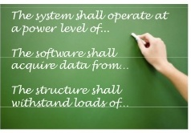
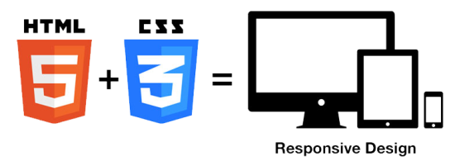
System requirements (1/2)
Integrative software solution for the analysis of multivariate heterogeneous biomedical time-series
Implemented as a web platform
Software logic layer on the server written in Java
Interface towards the user implemented with web development technologies (HTML5, CSS3, TypeScript...).
Multiple input file formats: European data format (EDF) and EDF+, textual format for signals and annotations, images formats, meta-data

Slide 5
System requirements (2/2)
Visualization of signals in 2D (records inspection) and specific body disorders in 3D using graphical hardware
Time-series preprocessing, such as signal filtering and data transformations
Feature extraction – features chosen by: 1) a medical expert system implemented in the platform, 2) an expert user;
A large number of features need to be supported by the platform, general and domain-specific
Machine learning: feature selection, classification, regression, and prediction algorithms
Results reporting in contemporary formats (e.g. PDF).
Input
data
Pre-processing
Feature extraction
Machine learning
Reporting
Visualization
parallelization

Slide 6
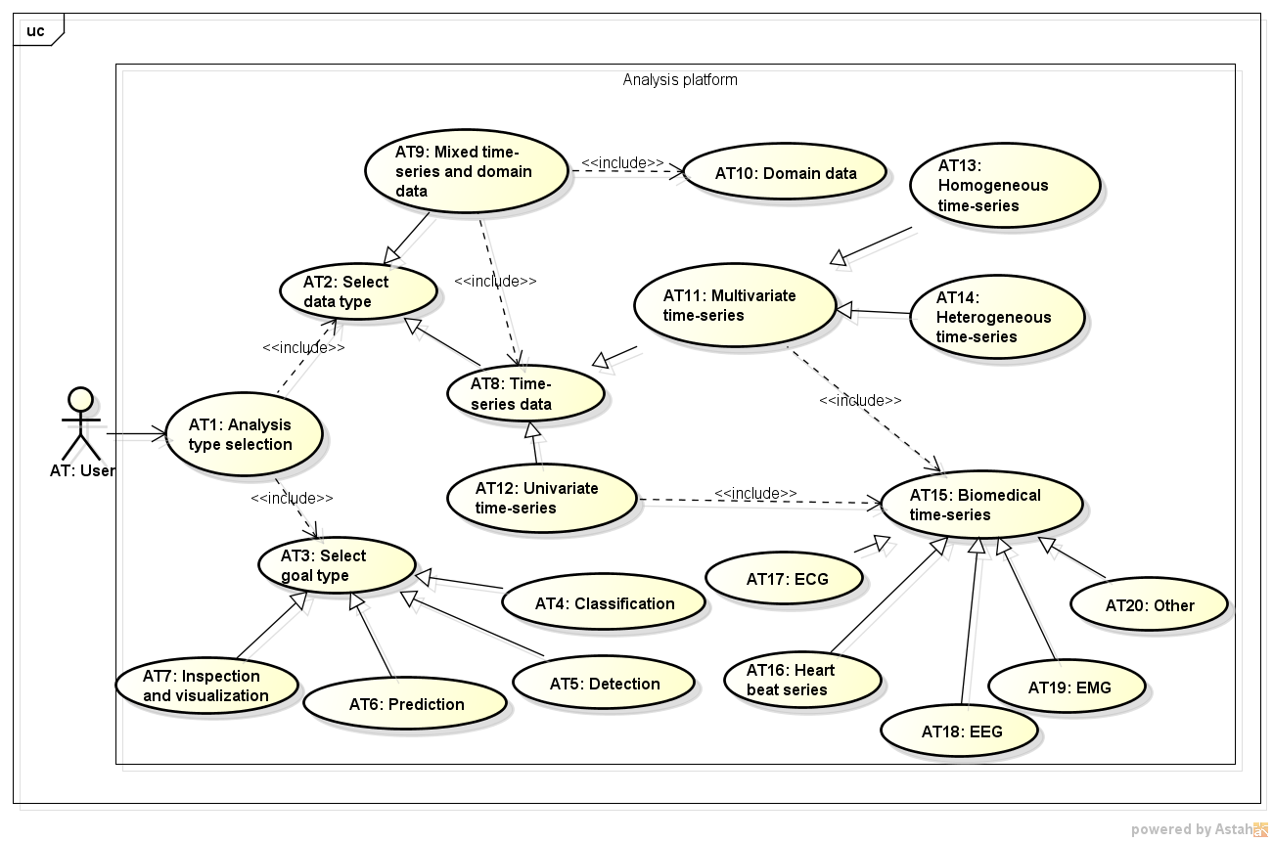
UML use case based modeling (1/2)
The analysis process in the web platform is divided into 8 steps:
Analysis type selection
Scenario selection
Input data selection
Records inspection
Records preprocessing
Feature extraction
Model construction
Reporting
We also consider platform
administration and user
accounts use case diagrams
1. Analysis type selection

Slide 7
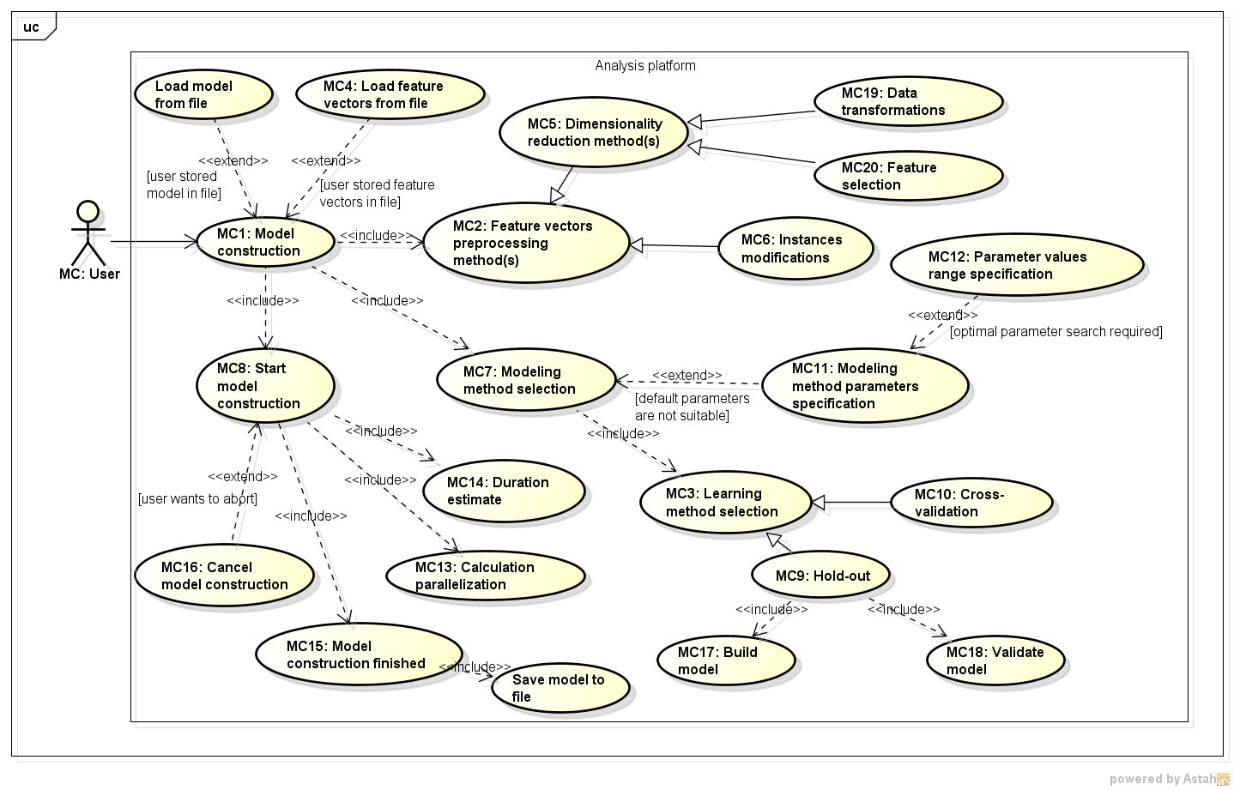
UML use case based modeling (2/2)
7. Model construction

Slide 8
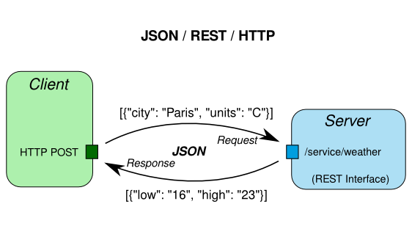
Platform architecture
Envisioned as a web portal, thin client – ease of remote access, wider user base than “classical” desktop apps
Client: Angular 2 for development (TypeScript, JavaScript), HTML5, CSS3, BootStrap, WebGL
Server: Java 8, Spring Boot, JPA (e.g. Hibernate), a DBMS (e.g. h2)
Client-to-Server connection via RESTful protocol (HTTP(S): POST/PUT/GET/DELETE)
Execution improvements: paralellization and modularization

Slide 9
Conclusion
Early stage report of the work on an innovative web platform for biomedical time-series analysis
We have shown the requirements and architecture needed to support the development
The near-future focus will be the implementation of simple analysis scenarios, probably for a single biomedical time-series (e.g. ECG or EEG)

Slide 10
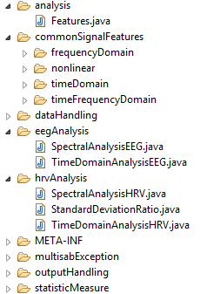
Current progress
Database architecture is defined, models are mostly implemented
h2 DBMS is used
Data input and signal processing framework is under development
The algorithms from HRVFrame¹ and EEGFrame² are refactored and verified, new algorithms are added
Secure authentication is being tested

Slide 11
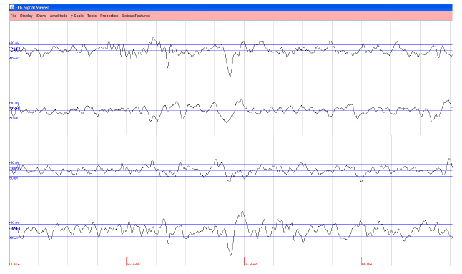
Thank you!
Questions?
This work has been fully supported by the Croatian Science Foundation under the project number UIP-2014-09-6889: A software system for parallel analysis of multiple heterogeneous time series with application in biomedicine (MULTISAB)

