Slide 1



Biomedical time series preprocessing and expert-system based feature extraction in MULTISAB platform
Alan Jovic¹, Davor Kukolja¹, Kresimir Friganovic¹,
Kresimir Jozic², Sinisa Car³
E-mail to: alan.jovic@fer.hr
¹ University of Zagreb, Faculty of Electrical Engineering and Computing, Zagreb, Croatia
² INA - industrija nafte, d.d., Zagreb, Croatia
³ Dom zdravlja Dubrovnik, Ambulanta Babino polje, Babino polje, Croatia

Slide 2
CONTENT
Motivation & goal
Predefined analysis scenarios with expert features
  Acute Myocardial Ischemia
  Atrial Fibrillation
  Congestive Heart Failure
Preprocessing
Feature extraction
Conclusion

Slide 3
Motivation & goal
In recent years, the need for web-based biomedical software is continuosly growing in the healthcare community:
  The need to reduce the cost of healthcare expenditure in developed countries
  To facilitate access to a better healthcare
Goal: development of a web-based system for automatic classification of human body disorders based on the analysis of biomedical signals
    Recommendations to medical specialists in diagnostics and early detection of various diseases

Slide 4
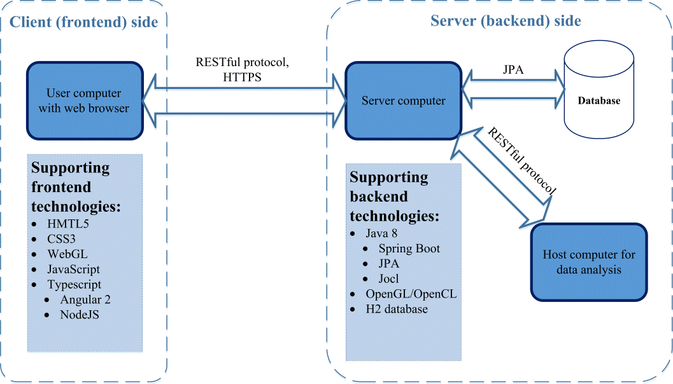
Architectural overview
4/17

Slide 5
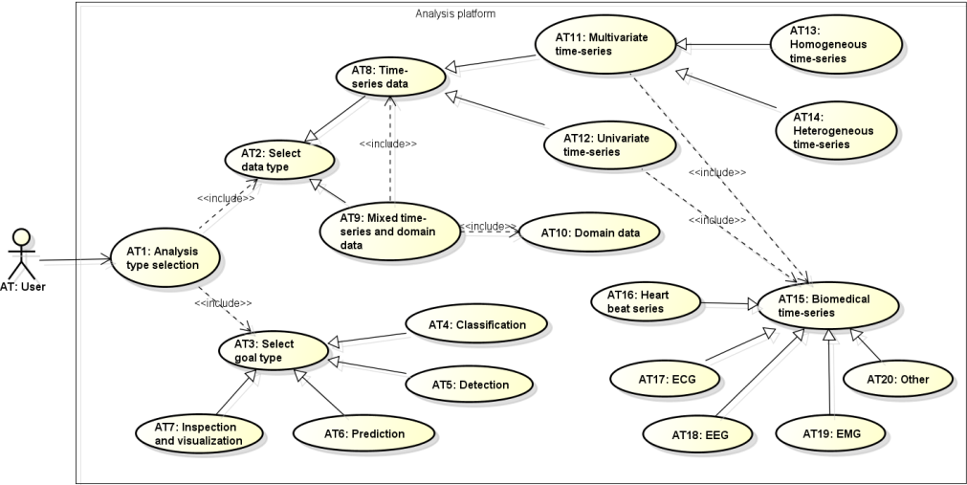
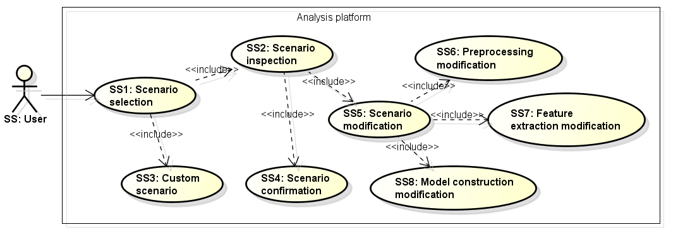
Scenarios for platform use
The data analysis process is divided into 8 steps:
  Analysis type selection
  Scenario selection
  Input data selection
  Records inspection
  Records preprocessing
  Feature extraction
  Model construction
  Reporting
Analysis type selection
Scenario selection

Slide 6
Predefined analysis scenarios with expert features
Scenario selection UI enables the user to select:
  Predefined scenario
  Construction of a completely new scenario through full customization
The predefined scenarios contain necessary preprocessing steps and expert features that are to be extracted from signals, which are selected by the medical expert system specifically designed for this purpose

Slide 7
MULTISAB expert system
Implementation of the medical expert system is a continuously evolving process that gradually introduces new predefined scenarios
  New scenarios are based on currently valid medical guidelines, standards, consultations with medical specialists, and relevant medical and biomedical engineering literature
MULTISAB expert system includes the recommended features for detection of:
  Acute myocardial ischemia (AMI),
  Atrial fibrillation (AF),
  Congestive heart failure (CHF)

Slide 8
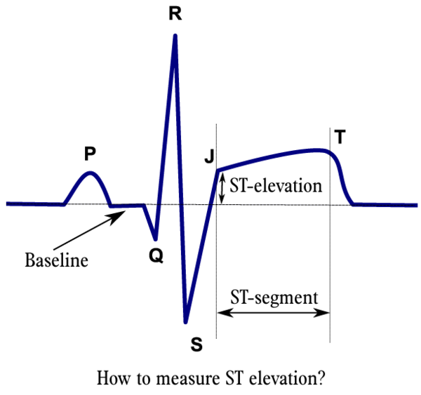
Diagnosis of Acute Myocardial Ischemia
According to the medical guidelines, criteria for diagnosis of AMI (in absence of left ventricular hypertrophy and left bundle branch block) are:
  ST elevation: New ST elevation at the J point in two contiguous leads,
  ST depression and T wave changes: New horizontal or down-sloping ST depression in two contiguous leads and/or T wave inversion in two contiguous leads with prominent R wave or R/S ratio >1

Slide 9
Acute Myocardial Ischemia: Expert ECG features
Morphological ECG features: ECG signal value (in regard to the baseline) at the J point, R/S ratio, T wave amplitude, and ST segment slope
Dynamical ECG features: standard deviation of ECG signal value at the J points
HRV features: LF, HF
QTV features: QTVnorm, QTVI
Additional expert features, which demand expanding the current frameworks, could include:
  Calculation of energy and entropy measures in wavelet domain
  Additional information in the ST segments, such as shape, width, height, curvature, etc.

Slide 10
Atrial Fibrillation
According to the medical guidelines, and with up to date medical research, AF is associated with the following changes in ECG:
  Lack of discrete P waves
  Fibrillatory or f waves are present at a rate that is generally between 350 and 600 beats/minute
  Ventricular response follows no repetitive pattern; the variability in the intervals between QRS complexes is often termed “irregularly irregular”
  The ventricular rate, especially in the absence of AV nodal blocking agents or intrinsic conduction disease, usually ranges between 90 and 170 beats/min
  The QRS complexes are narrow, unless AV conduction through the His Purkinje system is abnormal due to functional (rate-related) aberration, pre-existing bundle branch or fascicular block, or ventricular preexcitation with conduction down the accessory pathway

Slide 11
Atrial Fibrillation: Expert ECG features
Morphological ECG features: P wave absence, ﬁbrillatory rate, QRS complexes duration
Short-term HRV features : Heart rate, SDNN, RMSSD, pNN50, LF, HF, LF/HF ratio, approximate entropy (ApEn), sample entropy (SampEn)
Long-term HRV features : Total power spectral density (TP), VLF, 1/f power-law exponent α
Additional expert features, which demand expanding the current frameworks, could include calculation of wavelet entropy (WE) or relative wavelet energy (RWE)
  Based on the wavelet transformation of the TQ interval

Slide 12
Congestive Heart Failure
ECG manifestations of CHF are unspecific
  In the guidelines there is only a statement that an abnormal ECG increases the likelihood of the diagnosis of CHF
The medical diagnosis of CHF is based on presenting signs and symptoms, patient’s prior clinical history, physical examination and resting ECG
  If all the elements are normal, CHF is highly unlikely
  If at least one element is abnormal, plasma natriuretic peptides (NPs) should be measured, to identify those who need echocardiography
  Echocardiography is the most useful and widely available test in patients with suspected CHF used to establish the diagnosis

Slide 13
Congestive Heart Failure : Expert ECG features
Morphological ECG features: Q wave amplitude, PR interval duration, P peak amplitude, R peak amplitude, QRS complex duration, ratio of QT segment and heart rate corrected QT segment (QT/QTc), S wave duration in leads I, V5, V6, V1 and V2, R wave duration in leads V5 and V6
Short-term HRV features: Heart rate, short term detrended fluctuation analysis coefficient α1 (DFA α1), symbolic dynamics one variation pattern (1VP), LF, SDNN
Long-term HRV features: VLF, 1/f power-law exponent α
Although some features of heart rate turbulence (HRT), such as turbulence slope (TS), have significant predictive value, they are not used in the expert system because they cannot be calculated from all ECG recordings

Slide 14
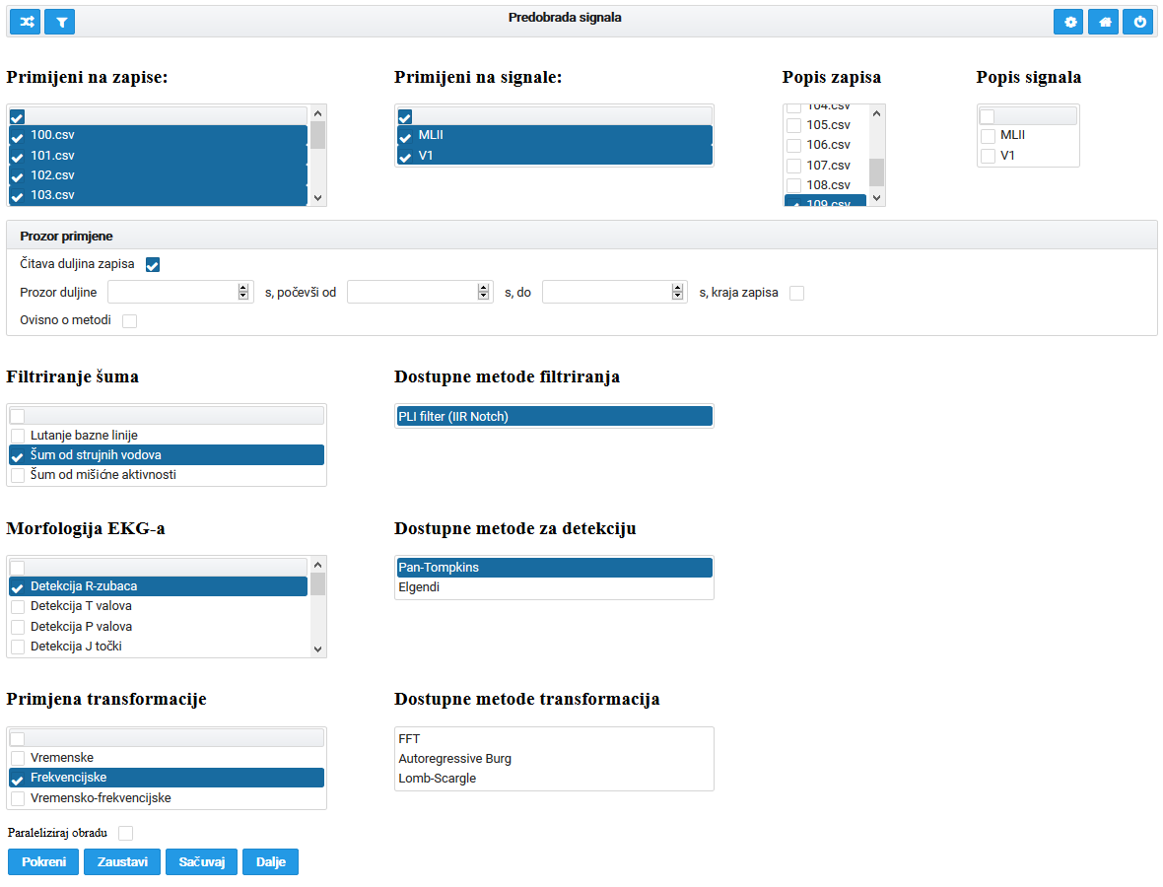
Preprocessing
Records preprocessing assumes various procedures for:
  Signal filtering,
  Characteristic waveform detection,
  Data transformations

Slide 15
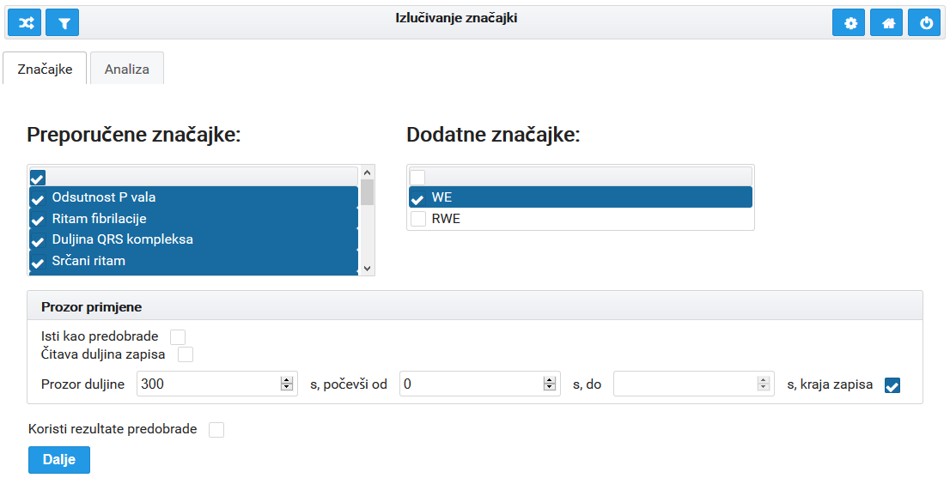
Feature extraction
Central step in the analysis of biomedical time-series
Feature extraction UI for AF detection analysis scenario

Slide 16
Conclusion
Progress report of the work on an innovative web platform for biomedical time-series analysis
Description of an expert feature recommendation system for ECG analysis through predefined analysis scenarios
  Initial version of the MULTISAB expert system includes the detection of AMI, AF, and CHF from ECG signals.
We expect that in a few months a fully operational version will be available in Croatian and in English
  The functionality will be limited to the first six steps, ending with the possibility of calculated features download, thus enabling further independent data mining and reporting

Slide 17
Thank you!
Questions?
This work has been fully supported by the Croatian Science Foundation under the project number UIP-2014-09-6889: A software system for parallel analysis of multiple heterogeneous time series with application in biomedicine (MULTISAB)

