Slide 1



Parallelization in biomedical time series analysis web platform: the MULTISAB project experience
Alan Jovic¹, Kresimir Jozic², Davor Kukolja¹,
Kresimir Friganovic¹, Mario Cifrek ¹
E-mail to: alan.jovic@fer.hr
¹ University of Zagreb, Faculty of Electrical Engineering and Computing, Zagreb, Croatia
² INA - industrija nafte, d.d., Zagreb, Croatia

Slide 2
CONTENT
Motivation & goal
MULTISAB platform structure
Parallelization candidate locations
Parallelization implementation
Validation od cardiac rhythm records
Conclusion

Slide 3
Motivation & goal
Complexity of biomedical time series (BTS) processing
The need for efficient web-based biomedical software is continuosly growing in the healthcare community
Goal: development of a web platform for automatic classification of human body disorders based on the analysis of biomedical signals
    Achieving efficient calculations through parallelization is an important aspect of the platform!

Slide 4
MULTISAB platform structure
Three (sub)projects:
  Frontend
    browser based UI
  Backend
    requests & session handling
    database communication
  Processing
    BTS analysis frameworks
Frameworks
Record input handling
Preprocessing
Signal visualization
General time series features
Specific (domain) time series features
Feature extraction
Expert system recommendations
Data mining
Reporting

Slide 5












MULTISAB platform structure
Extensive use of many contemporary technologies

Slide 6
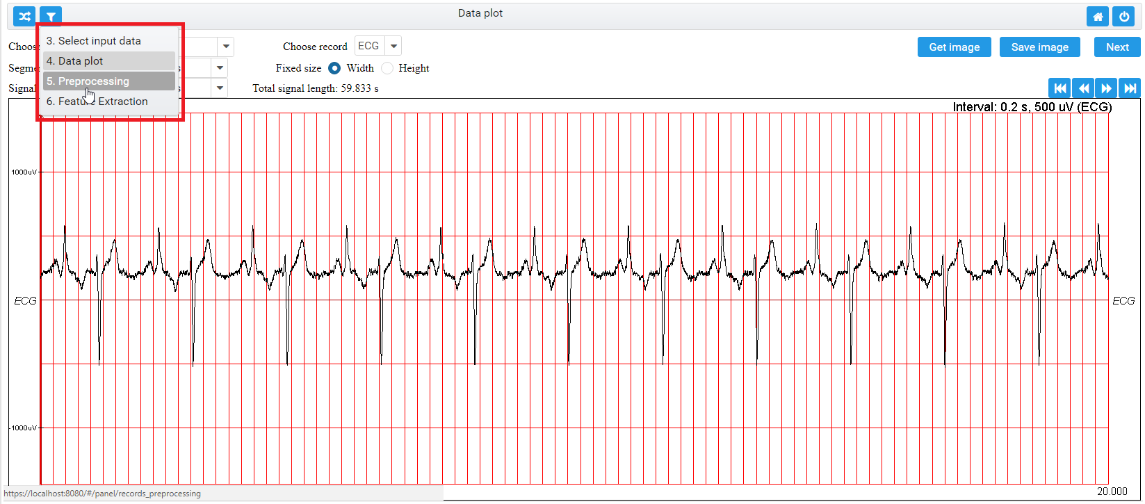
MULTISAB platform structure

Slide 7
Parallelization candidate locations
The computationally most intensive parts of the process
  Preprocessing
    Filtering, power density estimates, time-frequency methods
  Feature extraction
    Focus of this work
  Data mining
    Classification algorithms (ANN, SVM, random forest)

Slide 8
Parallelization candidate locations
Feature extraction
  Attempt at parallelization of BTS features calculation directly on GPU using Aparapi API (Java OpenCL library)
    FAILED
  Main reasons for failure:
    the nature of the algorithms (conditional next-step execution, non-trivial mathematical operations)
    overhead of run-time generation of OpenCL kernel due to code dissasembly
  Conclusion: Java multi-threading should be used instead

Slide 9
Parallelization implementation
Assumptions for starting feature extraction:
  One or more patient records uploaded and preprocessed earlier
  Records may contain heterogeneous signals, e.g. 10 EEG trails, 2 ECG trails
  Number of feature extraction iterations is equal to the number of different signal types (i.e. ECG, EEG...) in the records.

Slide 10
Parallelization implementation
Assumptions for starting feature extraction:
  All records contain the same types and numbers of signal trails.
  Each iteration is performed on one signal type in all records
  All signals in all records are of equal duration, if not, extraction is performed only until the end of the shortest signal trail
Note: user may select only a portion of uploaded records and signals for analysis

Slide 11
Parallelization implementation
Feature extraction parameters need to be set:
  The list of features that need to be extracted for each iteration
  The list of feature parameters with values for each feature
  The starting time in the record from which the feature extraction process starts (the same for all iterations).
  The analyzed segment width (the same for all iterations).
  The final time in the record until which the analysis is performed (the same for all iterations).

Slide 12
Parallelization implementation
Parallelization procedure
  if (no. segments in signal > 1), process segments in parallel until all are analyzed
  else if (no. signals of the same type > 1), process signals in parallel until all the signals are analyzed*
  else if (no. records > 1), process records in parallel until the records are analyzed.
  else // only one record with one signal type and one segment
  the parallelization is not performed and the record is analyzed in the main thread.
  * Note: a special case for the implemented bivariate features is that all signal pairs (e.g. for calculation of the mutual information feature) are analyzed in parallel.

Slide 13
Parallelization implementation
Extraction of the list of features in a single segment, signal, or record always proceeds sequentially (for easier synchronization due to varying algorithms’ complexities)
Limit the degree of parallelization: no. logical cores – 1
Synchronization: all threads need to finish with the current feature extraction task before moving on to the next parallelization task (main thread waits).

Slide 14
Parallelization validation
Cardiac rhythm records from well-known MIT-BIH Arrhythmia Database available at PhysioNet web portal
A total of 27 time domain, frequency domain and nonlinear heart rate variability features (standardly used as well as experimentally used features)
The experiments were run on Intel Core i7-4790 CPU @3.6 GHz with 16 GB RAM and 8 logical cores, of which 7 were used for parallelization.

Slide 15
Parallelization validation
No. of analyzed record segments, with their length | Parallel / sequential execution | Number of included records
 |  | 1 | 12 | 48
85 segments, each 20 s | parallel | 116±30 | 357±14 | 1135±79
 | sequential | 103±14 | 393±15 | 1304±66
18 segments, each 90 s | parallel | 145±13 | 447±9 | 1506±23
 | sequential | 178±8 | 962±29 | 3372±13
7 segments, each 240 s | parallel | 200±17 | 890±43 | 2519±12
 | sequential | 266±16 | 1973±20 | 8002±42
3 segments, each 560 s | parallel | 315±7 | 1966±23 | 7858±204
 | sequential | 531±16 | 4268±117 | 17672±115
2 segments, each 840 s | parallel | 466±7 | 3556±49 | 14781±244
 | sequential | 766±29 | 6181±55 | 26395±223
Experiments run 5 times, mean and standard deviation are reported in milliseconds

Slide 16
Conclusions
Maximum effect of multithreading for a general BTS analysis may be achieved for:
  long segments
  the number of segments given as multiple of the number of used logical cores
Except for the analysis of a few records with very short segments, parallelization is beneficial

Slide 17
Conclusions
Future work:
  Increase degree of parallelization
  Implement parallelization for specific preprocessing and data mining methods
  Explore efficient parallelization of multivariate features

Slide 18
Thank you!
Questions?
This work has been fully supported by the Croatian Science Foundation under the project number UIP-2014-09-6889: A software system for parallel analysis of multiple heterogeneous time series with application in biomedicine (MULTISAB)

