Slide 1



An overview and comparison of free Python libraries for data mining and big data analysis
Igor Stančin, Alan Jović
E-mail to: {igor.stancin, alan.jovic}@fer.hr
University of Zagreb Faculty of Electrical Engineering and Computing, Zagreb, Croatia

Slide 2
CONTENT
Motivation & goal
Core libraries
Data preparation
Data visualization
Machine learning
Deep learning
Big data
Conclusion

Slide 3
Motivation & goal
Python’s massive growth in usage → why?
Many open-source libraries and tools → 20+ are examined
Many options/algorithms for machine learning / deep learning → Compare and use the most appropriate

Slide 4
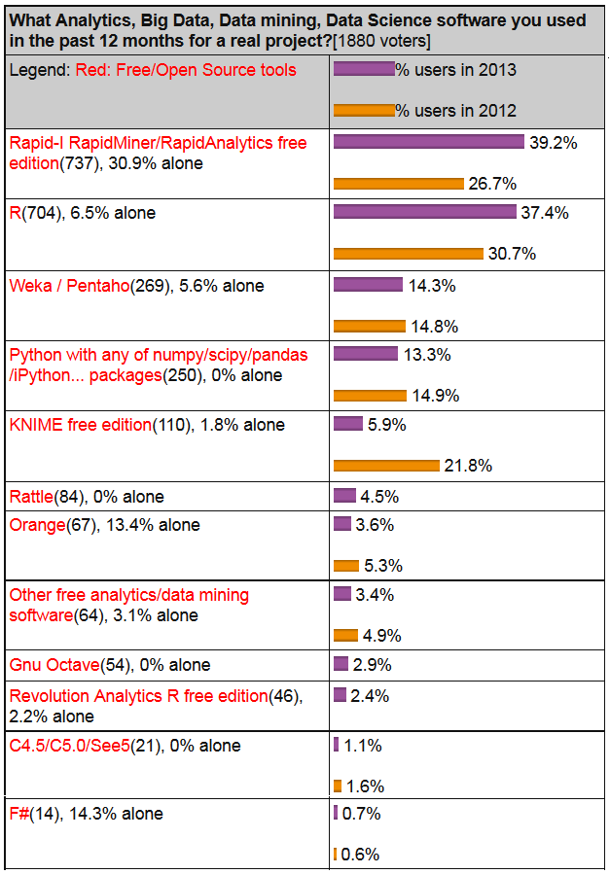
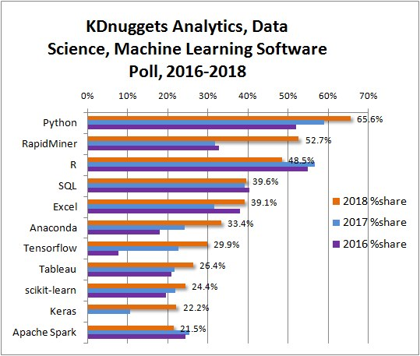
Motivation & goal
KDnuggets 2013 poll: KDnuggets 2018 poll:

Slide 5
Libraries popularity
Library | Stars | Forked | Contributors | Activity
NumPy | 9621 | 3318 | 726 | 28 (103)
SciPy | 5418 | 2690 | 685 | 21 (101)
Cython | 3833 | 799 | 275 | 10 (85)
pandas | 18134 | 7233 | 1407 | 65 (217)
PyTables | 801 | 164 | 60 | 0 (0)
h5py | 1042 | 288 | 98 | 3 (6)
Tabel | 11 | 0 | 1 | 1 (1)
Matplotlib | 8688 | 3966 | 787 | 20 (218)
seaborn | 5722 | 905 | 87 | 0 (0)
Plotly | 4569 | 1068 | 68 | 5 (38)
Bokeh | 8969 | 2398 | 346 | 11 (52)
ggplot | 3429 | 539 | 13 | 0 (0)
scikit-learn | 33337 | 16358 | 1253 | 38 (94)
mlpy | 5 | 2 | 1 | 0 (0)
Shogun | 2312 | 891 | 153 | 8 (57)
mlxtend | 2033 | 475 | 46 | 3 (17)
TensorFlow | 120547 | 72008 | 1834 | 194 (1888)
Keras | 38196 | 14584 | 773 | 20 (53)
PyTorch | 24781 | 5878 | 934 | 152 (913)
Caffe | 27016 | 16335 | 267 | 0 (0)
Caffe2 | 8407 | 2130 | 196 | 0 (0)
mrjob | 2367 | 570 | 82 | 3 (143)
Dumbo | 1037 | 161 | 6 | 0 (0)
Hadoopy | 245 | 62 | 3 | 0 (0)
Pydoop | 168 | 53 | 11 | 1 (18)
Spark (PySpark) | 20576 | 18057 | 1330 | 78 (246)
Hadoop (Streaming) | 8567 | 5360 | 155 | 58 (456)

Slide 6
Core libraries
NumPy – highly efficient vectorized computing
SciPy – implementations of algorithms for scientific purposes – relying on Netlib repository
Cython – calling C functions from Python, C-types of variables – accelerates calculations

Slide 7
Data preparation
Data preprocessing & data manipulation (wrangling)
pandas dominates the field
  Wide range of data I/O handling
  Data transformations and cleaning (DataFrame)
  Statistical calculations (EDA)
  Basic visualizations (EDA)
Competition: PyTables and h5py – support only HDF5 data type, suitable for large and heterogeneous datasets

Slide 8
Data visualization
High competition in this field
Based on the number of easily accessible functionalities, the rank would be:
Plotly – the most powerful library in data visualization field, main flaw is a relatively unintuitive syntax; integrateable into web pages via Dash
seaborn – built on top of Matplotlib, many graphs, easy to learn for beginners
MatplotLib – Python implementation of Matlab-like plots, low level, lots of options for customization
Other: Bokeh (for interactive plots in webpages), ggplot

Slide 9
Machine learning
scikit-learn dominates the field
Pros:
  Implementation of many machine learning algorithms (classifiers, regressors, clustering methods)
  Supports feature selection & dimensionality reduction
  Variety of evaluation metrics for all types of analyses
Cons:
  Lacks many standard decision tree and inductive rules implementations
  Lacks association rules mining implementations
  Lacks some other interesting algorithms (e.g. rotation forest, full Bayesian network, stacking classifiers, fuzzy c-means clustering)
Competition: Shogun (not as many algorithms as scikit-learn, but has different tree learners) and mlxtend (the least algorithms, but has association rules)

Slide 10
Deep learning
Very popular in Python – high competition
TensorFlow, Keras and PyTorch are currently the most popular libraries (Caffe/2, Theano and others not as much)
TensorFlow (Google) – low level, detailed, supports most options
Keras – built on top of TensorFlow and other libraries (high level ANN API), easy to learn, runs seamlessly on CPU and GPU, a bit fewer functionalities than TensorFlow
PyTorch (Facebook) - runs code in a more procedural fashion, unlike TensorFlow, where one first needs to design the whole model and then run it within a Session, easy to learn and debug, number of functionalities comparable to TensorFlow

Slide 11
Big data
Not specifically designed to Python, but most big data tools support Python (R, Java and Scala are equally popular here)
Two most popular:
  PySpark (Python specific) for Spark, may use Spark-internal Mllib for machine learning
  Hadoop Streaming (any language) for Hadoop MapReduce
Several Python libraries for running Hadoop:
  mrjob – multi-step MapReduce jobs in pure Python, good documentation, does not support complex tasks, a bit slow
  Dumbo – has advanced functionalities, not rich documentation, wrapper around Hadoop Streaming, not maintained
  Hadoopy – similar to Dumbo, better documentation, not maintained
  Pydoop - wrapper around Hadoop pipes (C++ API for Hadoop)

Slide 12
Conclusion
Recommended Python stack for data mining / data science:
  Core: NumPy, SciPy, Cython
  Data preparation: pandas
  Visualization: Plotly, seaborn or MatplotLib
  Machine learning: scikit-learn
  Deep learning: TensorFlow, Keras, PyTorch
  Big data: Spark, Hadoop Streaming
Community support is vital for survival of Python open-source libraries, especially in a fast-evolving area such as data science

Slide 13
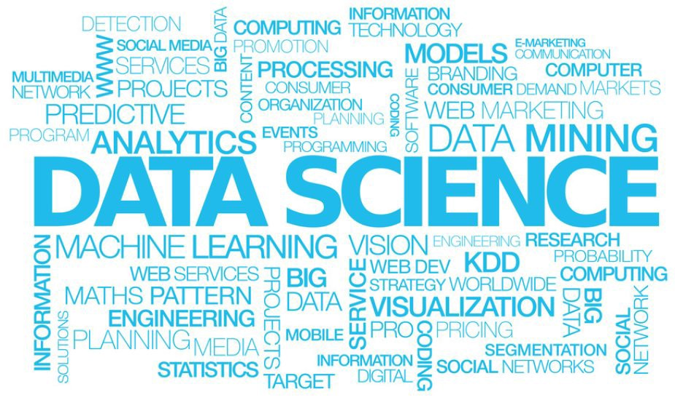
Thank you!
Questions?

