Slide 1
Clinical Decision Support Systems in Practice: Current Status and Challenges
Alan Jović, Igor Stančin, Krešimir Friganović, Mario Cifrek
E-mail to: alan.jovic@fer.hr
University of Zagreb Faculty of Electrical Engineering and Computing, Zagreb, Croatia

Slide 2
CONTENT
Motivation & goals
Related work
Successful implementations
Underlying technologies
Open challenges
Conclusions

Slide 3
Motivation & goals
Clinical decision support system (CDSS) – any computer program that implements one or more AI methods into clinical practice in order to enhance medical decisions based on existing data and organized knowledge
Medical personnel may use CDSS for diagnosis, prevention, treatment protocol recommendations, care-coordination, treatment outcome predictions, and other tasks
Development of CDSSs has been proceeding gradually, following the course of the improvements in AI algorithms, knowledge representation methods, software architectures and clinical data availability

Slide 4
Motivation & goals
Motivation:
AI “promises” to significantly improve healthcare
Many review papers, hard to grasp the state-of-the-art
Goals:
Offer a critical synthesis of current literature
Highlight the implementations and technologies, discuss challenges

Slide 5
Related work
EHR adoption – first step, limited use of AI in practice [Castaneda et al. 2015]
Six axes in CDSS development: data, knowledge, inference, architecture and technology, implementation and integration, and users, overview of historically successful implementations in the USA [Middleton et al. 2016]
Potential for ML methods to augment clinical practice in psychology and psychiatry, but very few successes [Dwyer et al. 2018]
High-performance medicine – clinical practice is only at the starting point of using advanced deep learning approaches, many pitfalls, lack of prospective studies [Topol 2019]

Slide 6
Related work
AI model assurance pattern: clinical setting, benchmark, ML model choices explanation, training and validation data sufficient to describe the clinical setting, independent test data, thorough ML process explanation [Picardi et al. 2019]
Many challenges, e.g. AI metrics such as accuracy, area-under-curve, and others often do not reflect clinical applicability, and especially any beneficial change in patient care; GDPR mandates the right to explanation [Kelly et al. 2019]
Data, such as multi-omics (genomics, proteomics, transcriptomics, etc.), clinical, behavioral, environmental, pharmaceutical research and development all have associated challenges for modeling and CDSS inclusion [Wang and Preininger 2019]
Use of deep learning in cardiology is still of limited extent in the number of conducted studies, they may suffer from a positive publication bias, which remains to be discovered by future meta-analysis studies; no reports on CDSS implementations of DL in cardiology [Krittanawong 2019]

Slide 7
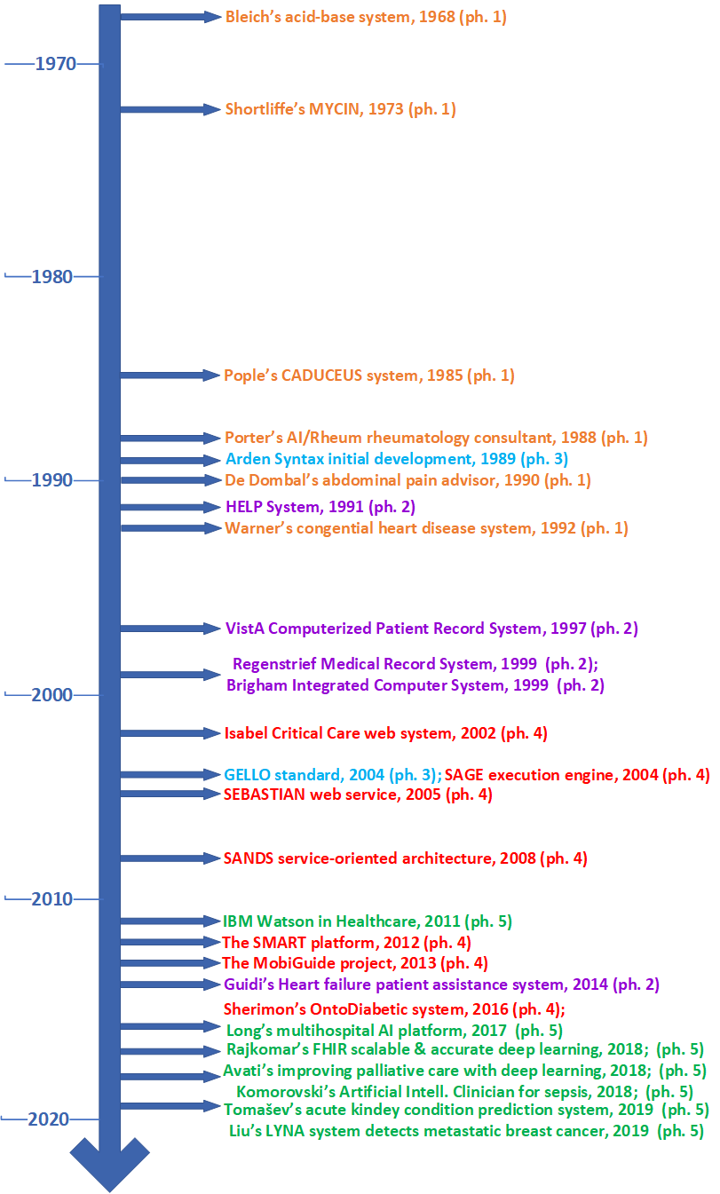
Successful implementations
The evolution of CDSS architectures [Wright and Sittig 2008]:
Phase 1: Standalone decision support system
Phase 2: Decision support integrated into clinical systems
Phase 3: Standards developed for sharing content between clinical decision support systems
Phase 4: Web service models for decision support systems
More recent, phase 5: big biomedical data analytics from the cloud and grid platforms using ML or DL approaches

Slide 8
Successful implementations
Since 2014, many US Food and Drugs Administration’s (FDA) approvals of proprietary AI algorithms and the accompanying platforms in healthcare
Fast-track FDA approval plan for AI algorithms in 2018
Full list of approved AI solutions not openly available, but currently more than 50 such AI algorithms exist, see e.g.
https://medicalfuturist.com/fda-approvals-for-algorithms-in-medicine/
Applications
personal health assessment (e.g., via smart wearable devices)
in primary care, or
in clinical settings

Slide 9
Underlying technologies
Symbolic methods
Rule-based systems (crisp and fuzzy)
Ontologies
Bayesian networks
Machine learning methods
Black-box models: support vector machine, artificial neural networks, decision tree ensembles
White-box models: linear and logistic regression, decision trees, induction rules
Deep learning methods
Convolutional neural networks
Recurrent neural netwotks (including GRU and LSTM)
Deep belief networks
Autoencoders

Slide 10
Open challenges – major
AI model transparency [Kelly et al. 2019, Dwyer et al. 2018, Wang and Preininger 2019, Krittanawong et al. 2019]
Standardization of DCSS integration into clinical workflow at insertion points [Middleton et al. 2016, Dwyer et al. 2018, Wang and Preininger 2019]
AI algorithms effectiveness – randomized control trials [Kelly et al. 2019, Dwyer et al. 2018, Wang and Preininger 2019, Krittanawong et al. 2019]
Standardization of EHR data – prerequisite for machine learning [Wang and Preininger 2019, Rajkomar et al. 2018]
Efficient external validation [Kelly et al. 2019, Dwyer et al. 2018]
Secure data integration from multiple sources [Kelly et al. 2019, Zhang et al. 2018]
Data representativeness [Dwyer et al. 2018, Wang and Preininger 2019, Krittanawong et al. 2019]
Regulation and rigorous quality control of AI devices [Kelly et al. 2019]

Slide 11
Open CDSS challenges – minor
Currently, too few prospective studies
Increasing trend of proprietary algorithms development
Positive publication bias in medical studies of machine learning and deep learning
Adversarial attacks on deep learning models as security risk
Computationally expensive analysis of physiological data
Integrative analysis of physiological with other clinical data is lacking
Rapid development of new technology – many legacy systems
Behavioral data are heterogeneous, difficult to obtain ground truths
Environmental data linking with EHR data is needed for precision medicine
Heterogeneity of multi-omics data impedes its analysis and integration
Better understanding of human-computer interaction for increased acceptance
Implementation issues: algorithms unavailable, too much training needed, not commercially viable
Replication of study should be possible – models, data and code should be made openly available
Reporting of model results should be more elaborate with respect to metrics used

Slide 12
Conclusions
A person working in a partnership with a CDSS should be better than the same person unassisted
Accurate interpretation of results (explainability) and understanding of the underlying AI technology are crucial for the future of CDSS
Learning and using deep learning models on-site by physicians – important next step, some advancements exist [Faes et al. 2019]
Successful implementations of CDSSs in practice are still uncommon
There are many challenges that need to be overcome before CDSSs become ubiquitous
Carefully conducted studies should show that the use of accurate and reliable CDSS is possible
Clinical practice would greatly benefit from introduction of AI algorithms into medical workflows

Slide 13
Literatura
Middleton et al., “Clinical Decision Support: a 25 Year Retrospective and a 25 Year Vision,” Yearb Med Inform, vol. 2016, S103–S116, 2016; doi:10.15265/IYS-2016-s034
Kelly et al., “Key challenges for delivering clinical impact with artificial intelligence,” BMC Medicine, vol. 17, p. 195, 2019; doi:10.1186/s12916-019-1426-2
Dwyer et al., “Machine LearningApproaches for Clinical Psychology and Psychiatry,” Annu. Rev. Clin. Psychol., vol. 14, pp. 91–118, 2018; doi:10.1146/annurevclinpsy-032816-045037
Topol, “High-performance medicine: the convergence of human and artificial intelligence,” Nature Medicine, vol. 25, pp. 44–56, 2019; doi:10.1038/s41591-018-0300-7
Picardi et al., “A Pattern for Arguing the Assurance of Machine Learning in Medical Diagnosis Systems,” in A. Romanovsky, E. Troubitsyna, F. Bitsch, Eds., SAFECOMP 2019, Lecture Notes in Computer Science, vol. 11698. Springer, Cham, pp. 165–179, 2019; doi: 10.1007/978-3-030-26601-1_12
Wang and Preininger, “AI in Health: State of the Art, Challenges, and Future Directions,” Yearb Med Inform, vol. 28, no. 1, pp. 16–26, 2019; doi:10.1055/s-0039-1677908
Krittanawong et al., “Deep learning for cardiovascular medicine: a practical primer,” Eur Heart J, vol. 40, no. 25, pp. 2058–2073, 2019; doi: 10.1093/eurheartj/ehz056
Wright and Sittig, “A Framework and Model for Evaluating Clinical Decision Support Architectures,” J. Biomed. Inform., vol. 41, no. 6, pp. 982–990, 2008; doi:10.1016/j.jbi.2008.03.009
Rajkomar et al., “Scalable and accurate deep learning with electronic health records,” npj Digital Med, vol. 1, p. 18, 2018; doi: 10.1038/s41746-018-0029-1
Zhang et al., “FHIRChain: Applying Blockchain to Securely and Scalably Share Clinical Data,” Comput Struct Biotechnol J, vol. 16, pp. 267–278, 2018; doi:10.1016/j.csbj.2018.07.004
Faes et al., “Automated deep learning design for medical image classification by health-care professionals with no coding experience: a feasibility study,” The Lancet Digital Health, vol. 1, no. 5, e232–e242, 2019; doi: 10.1016/S2589-7500(19)30108-6

Slide 14
Thank you!
Questions?

