Slide 1
A review of feature selection methods with applications
Alan Jović, Karla Brkić, Nikola Bogunović
E-mail: {alan.jovic, karla.brkic, nikola.bogunovic}@fer.hr
Faculty of Electrical Engineering and Computing, University of Zagreb
Department of Electronics, Microelectronics, Computer and Intelligent Systems

Slide 2
Content
Motivation
Problem statement
Classification of FS methods
Application domains
Conclusion

Slide 3
Motivation
Data pre-processing often requires feature set reduction
Too many features for modeling tools to find the optimal model
Feature set may not fit into memory (for big datasets, streaming features)
A lot of features may be irrelevant or redundant
Few available review papers available on the subject
Mostly focused on specific topics (e.g. classification, clustering)
Application domains are not discussed in detail

Slide 4
Problem statement
Effectively, there are four classes of features:
Strongly relevant – cannot be removed without affecting the original conditional target distribution, necessary for optimal model
Weakly relevant, but not redundant – may or may not be necessary for optimal model
Irrelevant – not necessary to include, do not affect original conditional target distribution
Redundant – can be completely replaced with a set of other features such that the target distribution is not disturbed (redundancy is always inspected in multivariate case)
Goal: develop methods to keep only strongly and weakly relevant features, remove all the rest

Slide 5
Classification of Feature Selection Methods
Feature extraction (transformation)
E.g. PCA, LDA, MDS... (not our focus)
Feature selection
Filters
Wrappers
Embedded
Hybrid
Structured features
Streaming features

Slide 6
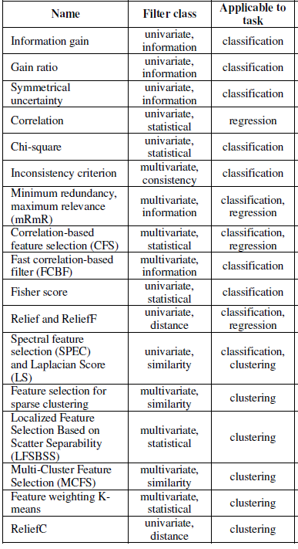
Filters
Select features based on a performance measure regardless of the employed data modeling algorithm
Many performance measures described in literature
Fast, but not as accurate as wrappers

Slide 7
Wrappers
Consider feature subsets by the quality of performance of a modeling algorithm, which is taken as a black box evaluator.
The evaluation is repeated for each feature subset
Very slow, highly accurate
Dependent on the modeling algorithm, may introduce bias

Slide 8
Embedded methods
Perform feature selection during the modeling algorithm's execution.
The methods are embedded in the algorithm either as its normal or extended functionality.
Also biased for the modeling algorithm
E.g. CART, C4.5, random forest, multinomial logistic regression, Lasso...

Slide 9
Hybrid methods
Combine the best properties of filters and wrappers.
Usual approach:
First, a filter method is used in order to reduce the feature space dimension space, possibly obtaining several candidate subsets.
Then, a wrapper is employed to find the best candidate subset.
Highly used in recent years
E.g. fuzzy random forest feature selection, hybrid genetic algorithms, mixed gravitational search algorithm...

Slide 10
Structured and Streaming features
Structured feature selection methods suppose that an internal structure (dependency) exists between features (groups, trees, graphs...)
Algorithms are mostly based on Lasso regularization
Streaming features selection methods assume that unknown number and size of features arrives into the dataset periodically and needs to be considered or rejected for model construction
Many approaches in recent years, particularly popular for modeling text messages in social networking
E.g. Grafting algorithm, Alpha-Investing algorithm, OSFS algorithm

Slide 11
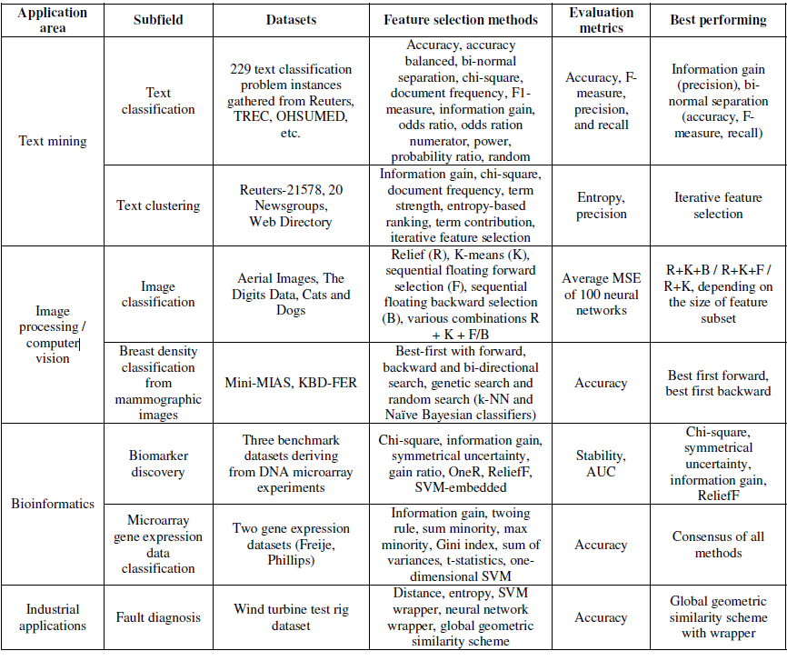
Application domains

Slide 12
Conclusions of the review
Hybrid FS methods, particularly concerning the methodologies based on evolutionary computation heuristic algorithms such as swarm intelligence based and various genetic algorithms show the best results
Filters based on information theory and wrappers based on greedy stepwise approaches also seem to show great results.
Application of FS methods is imporant in areas such as bioinformatics, image processing, industrial applications and text mining where high-dimensional feature spaces are present – the application areas are mostly drivers for development of advanced FS methodologies

