Slide 1



Abstract ID 691
MULTISAB: A web platform for analysis of multivariate
heterogeneous biomedical time-series
Jovic Alan¹, Kukolja Davor¹, Friganovic Kresimir¹, Jozic Kresimir² and Cifrek Mario¹
¹University of Zagreb Faculty of Electrical Engineering and Computing, Croatia
²INA – Industrija Nafte d.d., Avenija Veceslava Holjevca 10,Croatia
Contact e-mail: alan.jovic@fer.hr; davor.kukolja@fer.hr; kresimir.friganovic@fer.hr;
kjozic@gmail.com; mario.cifrek@fer.hr

Slide 2
Aims & objectives
We present a web-based platform for analysis of biomedical time series, developed under the ongoing MULTISAB (MULtivariate Time Series Analysis in Biomedicine) project
http://www.zemris.fer.hr/~ajovic/hrzz_multisab/platform.html
The platform is intended for researchers and clinicians to perform detailed analysis and set diagnosis based on imported biomedical time series data, as well as to visualize and inspect signals data
The access to MULTISAB can be achieved through web browsers, and is therefore available from any computer, without requisite installations. A major benefit of using the platform is that a user doesn’t need excessive computing power to do the analysis, as the computations are done remotely

Slide 3
Aims & objectives
The MULTISAB project is divided into three subprojects:
  Backend
  Frontend
  Processing
The processing subproject, located on the server side, is responsible for data analysis
All the processing frameworks are written in Java 9 and run on a host computer

Slide 4
Processing subproject frameworks
Key frameworks for processing and analysis of biomedical time series:
  Record input handling
  Preprocessing
  Signal visualization
  General time series features extraction
  Specific (domain) time series features extraction
  Expert system recommendations
  Data mining
  Reporting

Slide 5
Domain | Features
Time | auto correlation coefficient, Fano factor, mean, standard deviation, variance, minimum, maximum, PCA
Frequency | Fast Fourier transform PSD estimate, Burg autoregressive PSD estimate, Lomb-Scargle PSD estimate
Nonlinear | correlation dimension, space fill index (SFI), central tendency measure (CTM), largest Lyapunov exponent, recurrence plot, nonlinear forecasting, DFA, Higuchi dimension, Hurst exponent, 1/f power law alpha exponent, corrected conditional Shannon entropy, alphabet entropy, approximal entropy (ApEn), one dimensional Carnap entropy, correlation entropy, Renyi entropy, fuzzy ApEn, Sample entropy, Shannon entropy, cross recurrence, mutual dimension, synchronization likelihood, Allan factor, Lempel-Ziv complexity
ECG specific | R wave amplitude, QRS complex duration, P wave amplitude, P wave absence, P wave duration, T wave amplitude, T wave duration, ST segment duration, ST segment slope, QT interval duration, PR interval duration, J point amplitude, R/S ratio, Q wave amplitude, R wave duration, S wave duration, atrial fibrillatory rate
EEG specific | mean of first differences, mean of second differences, mean of first differences normalized, mean of second differences normalized, total PWR, delta band power, theta band power, alpha band power, beta band power, gamma band power, spectral entropy
HRV specific | AVNN, SDNN, RMSSD, pNNX, NNX, SDSD, SDANN, HRV triangular index, TINN, total PWR, ULF, VLF, LF, HF, LF/HF ratio, spectral entropy, standard deviation ratio
Features extraciton
General and domain-specific time series features implemented in the processing framework:

Slide 6
MULTISAB expert systems
Two phases of an expert system are implemented under the MULTISAB platform:
The first phase is designed to recommend a list of specific features intended for feature extraction (some cardiac diagnoses are currently supported), based on medical knowledge (guidelines and other scientific sources) about a disease
The second phase consists of a set of rules for reaching a specific diagnosis, for example for acute heart ischemia, which is done after the features are extracted

Slide 7
Analysis scenario
Use case: cardiac rhythm classification based on MIT-BIH Arrhythmia Database records
Steps:
  Start of a new analysis
  Selection of a predefined scenario for cardiac rhythm classification
  Upload of the data for the analysis
  Inspection and visualization of the uploaded data
  Selection of the various procedures for signal filtering, characteristic waveform detection, and data transformations
MULTISAB web platform – Analysis scenario

Slide 8
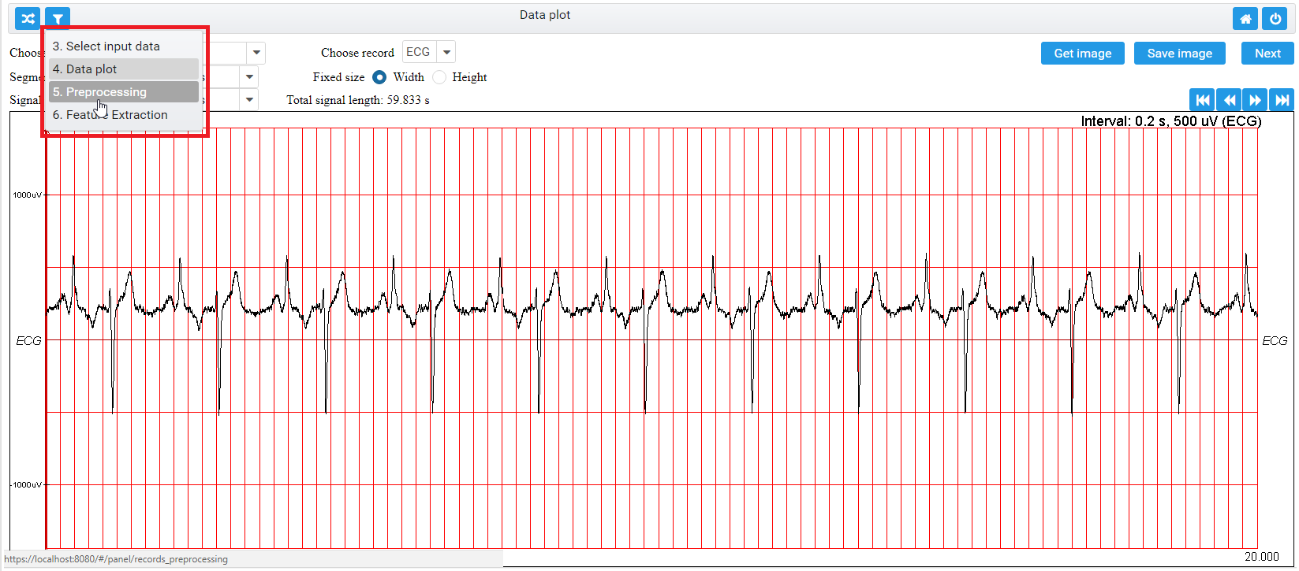
Analysis scenario
Feature selection – the user can select and download the extracted features
Model construction step – user can select model evaluation methods
Generate a report
MULTISAB web platform – inspection and visualization

Slide 9
Report for cardiac rhythm classification
The report created for cardiac rhythm
classification on MIT Arrhythmia Database

Slide 10
Conclusion
In this work, we have provided a brief view into the currently developing MULTISAB platform, with the focus on data analysis (processing) part
The progress made will soon enable on-the-web analysis of multiple biomedical time series for interested medical and biomedical engineering professionals
For near future work, more support for heterogeneous biomedical time series analysis and expand of the selection of currently implemented data mining methods is planned

Slide 11
References
1. Robbins, K.A.: EEGVIS: A MATLAB Toolbox for Browsing, Exploring, and Viewing Large Datasets. Front Neuroinform. 6, 17 (2012).
2. Tarvainen, M.P., Niskanen, J.P., Lipponen, J.K., Ranta-aho, P.O., Karjalainen, P.A.: Kubios HRV – Heart rate variability analysis software. Comput Methods Programs Biomed 113(1), 210-220 (2014).
3. Friganovic, K., Jovic, A., Jozic, K., Kukolja, D., Cifrek, M.: MULTISAB project: a web platform based on specialized frameworks for heterogeneous biomedical time series analysis - an architectural overview. In: Proc. Int. Conf. on Med & Biol Eng (CMBEBiH 2017), pp. 9-15. Springer Nature, Sarajevo, Bosnia and Herzegovina (2017).
4. Tang, J., Alelyani, S., Liu, H.: Feature Selection for Classification: A Review. In: Aggarwal, C. (ed.). Data Classification: Algorithms and Applications. CRC Press. (2014)
5. Heaton, J.: Encog: Library of Interchangeable Machine Learning Models for Java and C#. JMLR 16, 1243-1247. (2015).

Slide 12
References
6. Chang, C.-C., Lin, C.-J.: LIBSVM: a library for support vector machines. ACM TIST 2(27), 1-27. (2011).
7. Moody, G.B., Mark. R.G.: The impact of the MIT-BIH Arrhythmia Database. IEEE Engi-neering in Medicine and Biology Magazine 20(3), 45-50 (2001).
8. Jovic, A., Kukolja, D., Friganovic, K., Jozic, K., Car, S.: Biomedical Time Series Prepro-cessing and Expert-System Based Feature Extraction in MULTISAB Platform. In: Proc. Int. Conf. MIPRO 2017, pp. 349-354. IEEE, Opatija, Croatia (2017).
9. Jovic, A., Jovic, F.: Classification of cardiac arrhythmias based on alphabet entropy of heart rate variability time series. Biomedical Signal Processing and Control 31(2017), 217-230 (2017).
10. Narin, A., Isler, Y., Ozer, M.: Investigating the Performance Improvement of HRV Indices in CHF using Feature Selection Methods based on Backward Elimination and Statistical Si-gnificance. Computers in Biology and Medicine 45, 72-79 (2014).
11. Tibco Software, Inc. 2018. JasperReports® Library, Open Source Java Reporting Library. https://community.jaspersoft.com/project/jasperreports-library (last accessed: 2018/01/21).

Slide 13
Conflict of interest
The authors declare that they have no conflict of interest.
Acknowledgement
This work has been fully supported by the Croatian Science Foundation under the project number UIP-2014-09-6889.
Contact e-mail
alan.jovic@fer.hr; davor.kukolja@fer.hr; kresimir.friganovic@fer.hr; kjozic@gmail.com; mario.cifrek@fer.hr

